Slide 1
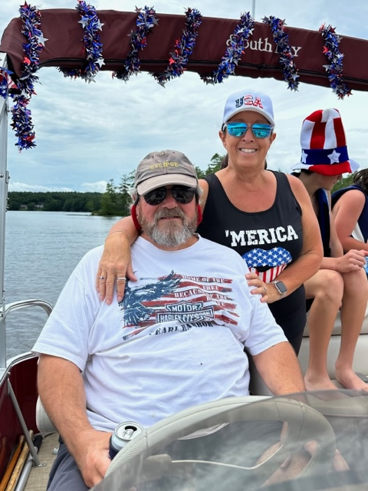
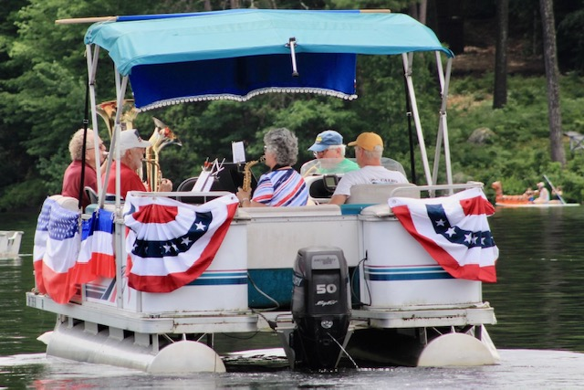
Welcome Mirror Lake Protective Association
Annual Meeting: July 15, 2023
Notes:
Welcome and special thanks to all who have sent in membership. Your generosity is so encouraging!
Membership envelopes are available if you need one. Steve Scapicchio has a record if you need to be reminded whether or not you joined.

Slide 2
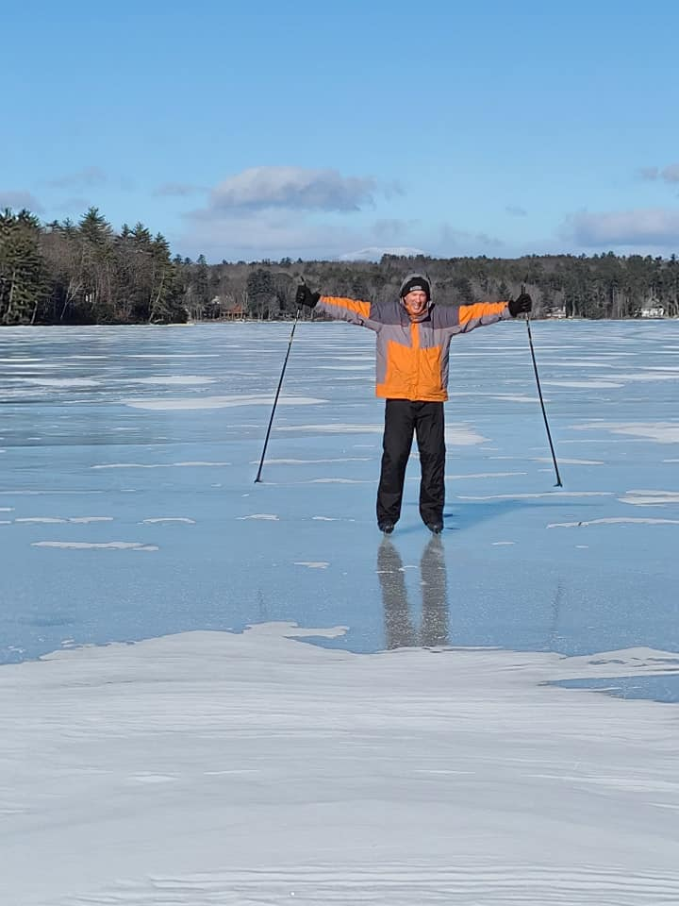
Agenda https://www.mirrorlakenh.org/wp-admin
Welcome
Approve Minutes
Treasurer’s Report
Nominations
Committee Reports
Water Quality
Land Conservation
6. Other Committees/Teams
7. Old and New Business
-Water Summit and Lakes Congress
- LakeSmart: A Lake-Friendly Living Program
8. Adjourn
Notes:
Quick look. Our meeting will end by 10:00am. Board members will stay around after the meeting in case you have additional questions.
Special time and attention will be devoted to our two primary areas of focus: ***Water Quality; Land Conservation

Slide 3
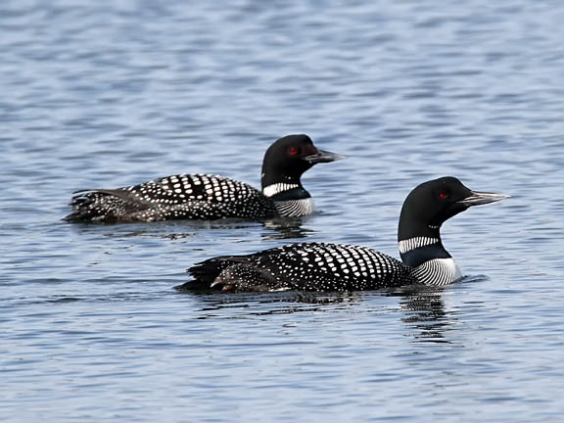
Minutes of the 2022 Annual Meeting
Fran O’Donoghue, Secretary
Notes:
Motion to accept the notes of the minutes included in the mailing from last year. Minutes are available on the website.
Second
Discussion
Yea/nay/abstain

Slide 4

Treasurer’s Report
Robin E. Muench, Treasurer
Notes:
Robin is not in town for the next couple of weeks, but worked to prepare the report. Our treasury grows slowly, but steadily.

Slide 5

Nominations
Nominating Committee: Steve Cloutier; Dusty Davies, Chair; John Dawson; Gene Kelley
Mirror Lake Protective Association Officers
MLPA Officers serve for one year
President: Kathy Sciarappa Nominated 2023
Vice President: Val Zanchuk Nominated 2023
Treasurer: Robin Muench Nominated 2023
Secretary: Fran O’Donoghue Nominated 2023
Mirror Lake Protective Association Board of Directors
MLPA Board of Directors serve for three years
Larry Gil (term expires 2023)
Dusty Davies (term expires 2023)
Steve Scapicchio (term expires 2025)
Gene Kelley (term expires 2025)
Steve Cloutier (term expires 2024)
Ann Torregrossa (term expires 2024)
Notes:
This is the slate of officers and directors. Officers are elected annually; directors serve for three year terms. Both Dusty Davies and Larry Gil would like to retain their positions and are running for office.
Move to accept the slate of officers as presented?
Second?
Discussion
Yea/nay/abstain
Round of applause for the board members who work so hard to follow the mission of the MLPA.

Slide 6
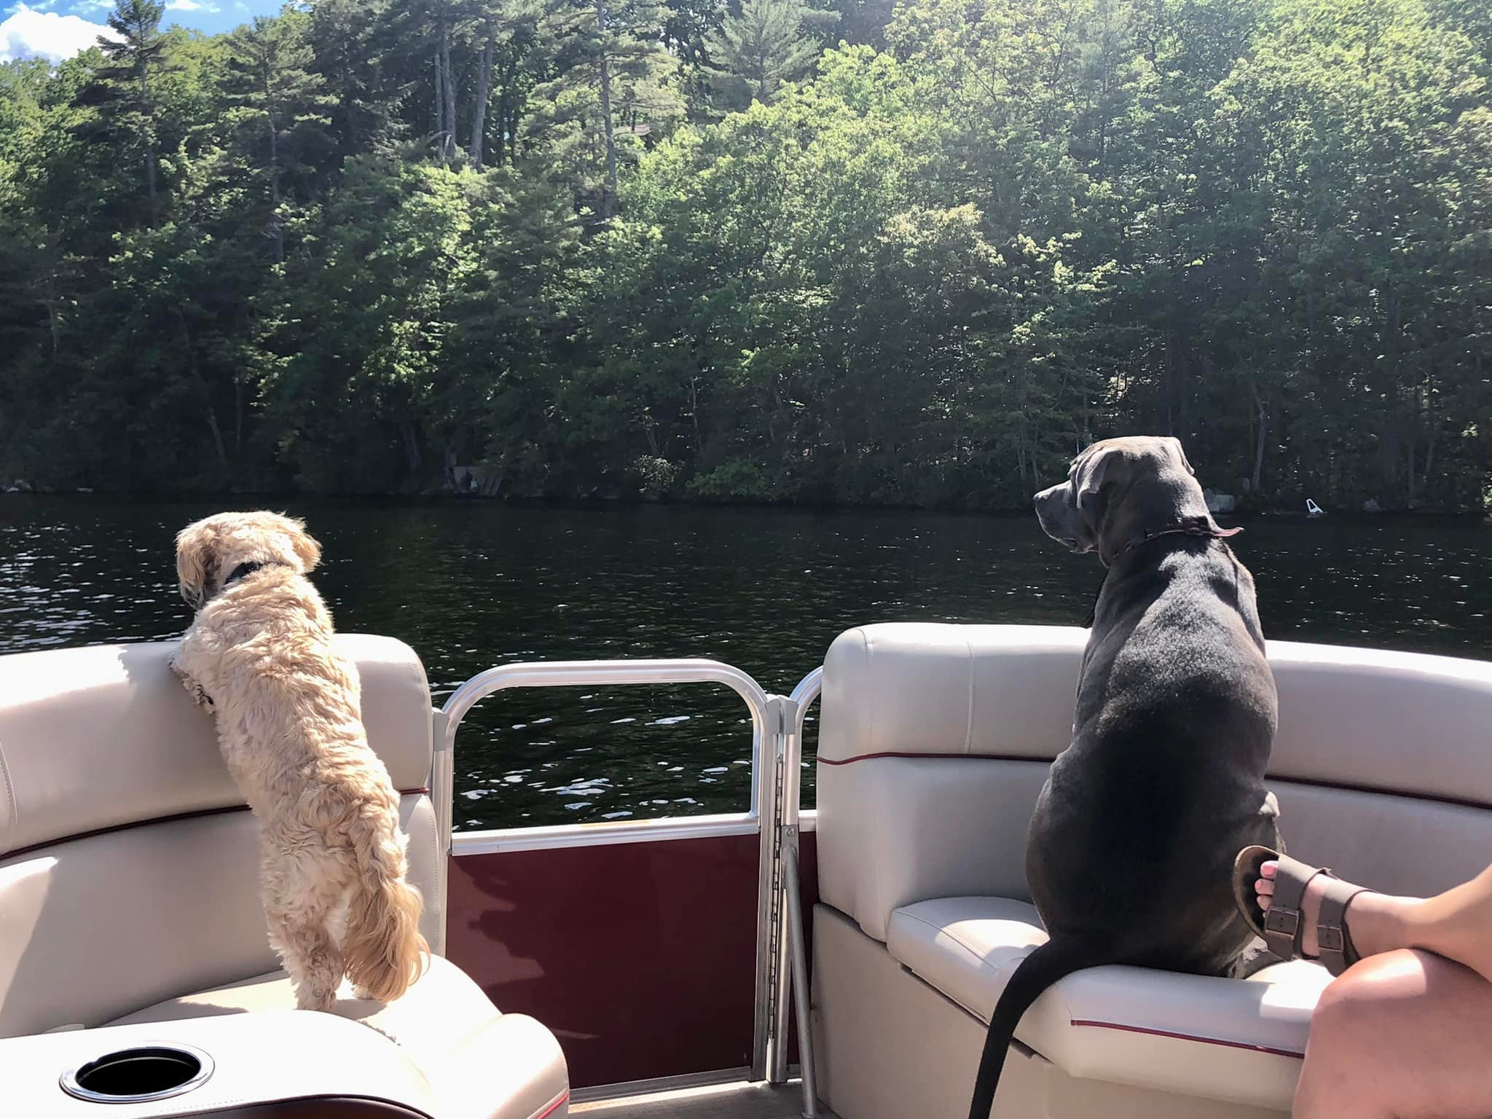
Committee Reports
Notes:
Our committees are very active and that is the way the mission of MLPA is met.

Slide 7
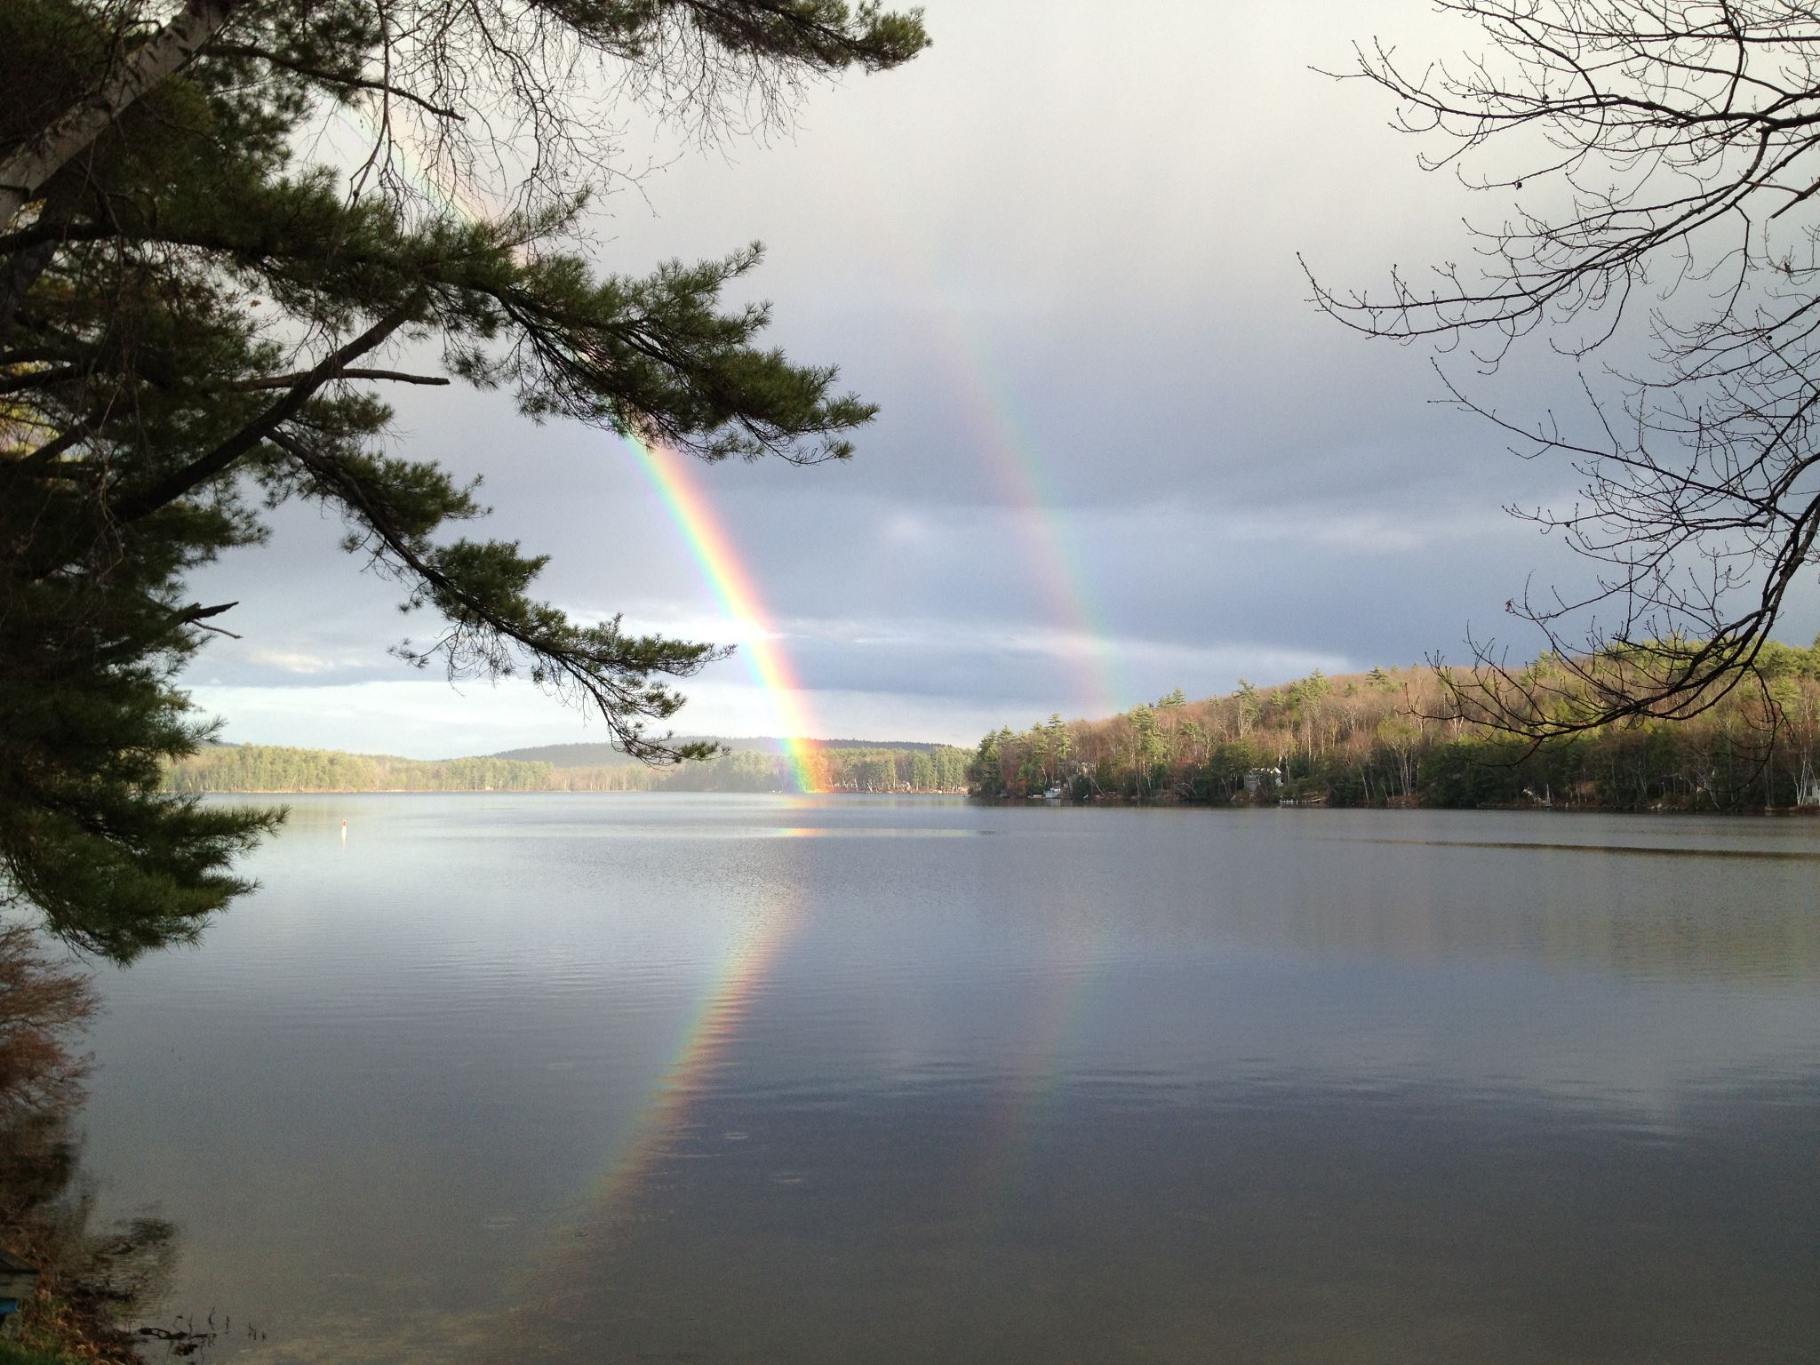
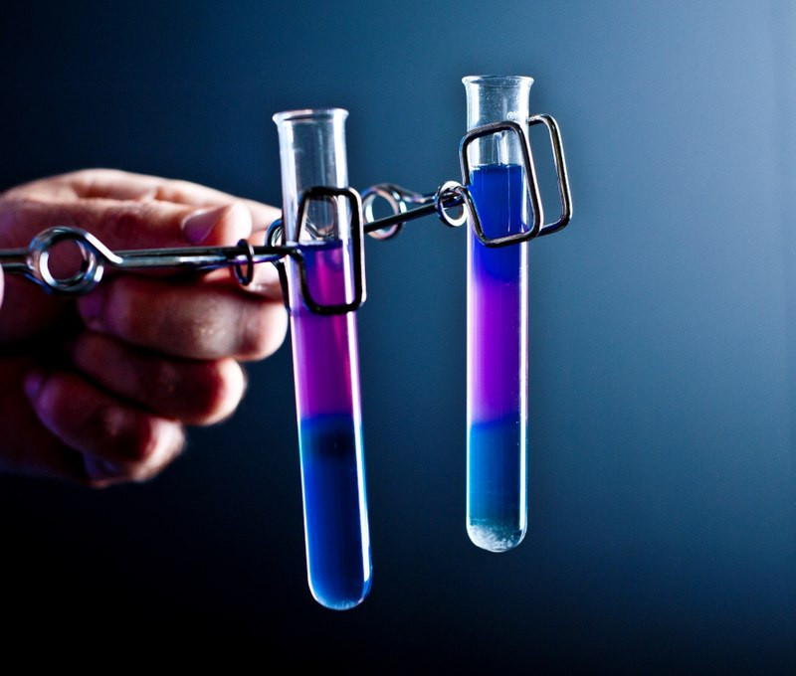
Water Quality
Notes:
Four Outbreaks on Mirror Lake 2008; 2014; 2019; 2021 https://www4.des.state.nh.us/onestoppub/TrophicSurveys/Mirror.Tuftonboro.Cyano.html
Our chief concern has been cyanobacteria and MLPA started much earlier than other lakes addressing the issues. Now, all NH lakes are deeply concerned. The body of knowledge around cyanobacteria is an evolving one and each year we learn more information. This is a big year for taking action on Mirror Lake.

Slide 8
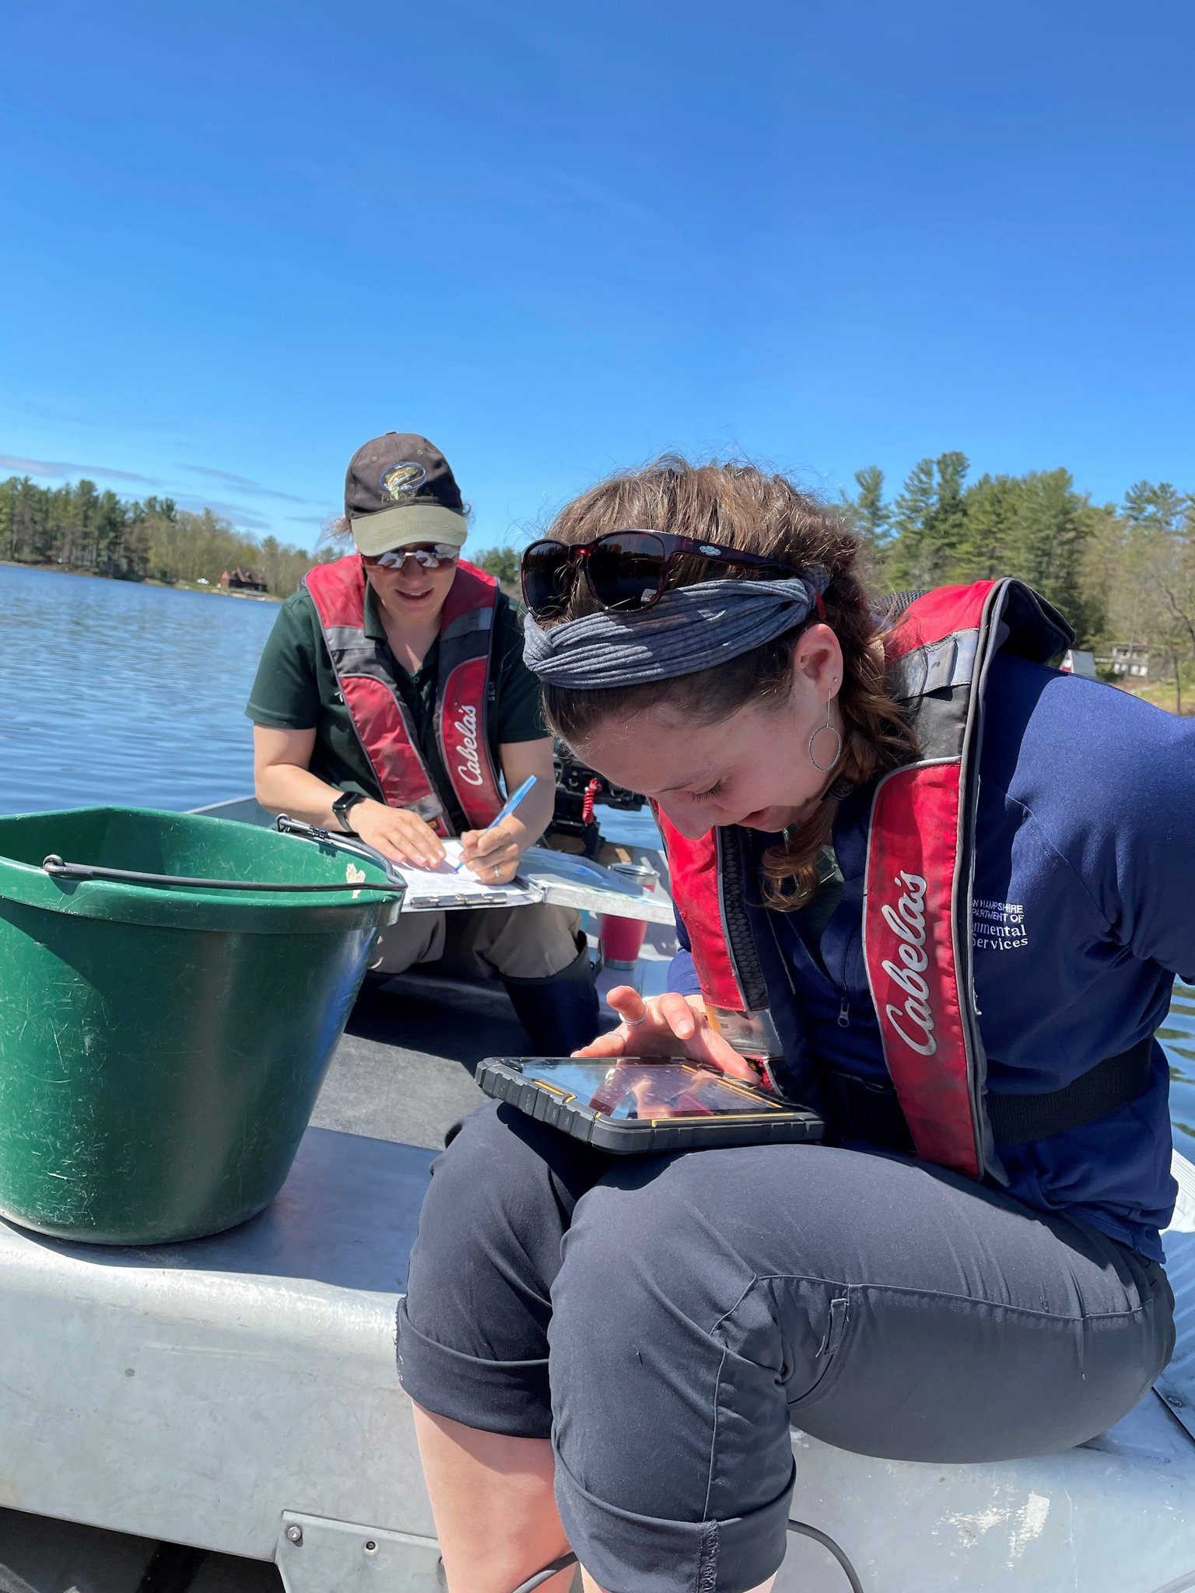

Dept of Environmental Services: Reporting
Kate Hastings: NHDES Cyanobacteria Harmful Algal Bloom Program Manager
Notes:
Kate Hastings replaced Amanda McQuaid (who is now working for UNH Extension service and serves us well. Some of our board members attended key meetings this winter and spring which helped formulate our plans to move forward with additional water testing and a new Watershed Management Plan. Kate has establish three concrete options for residents:
The bloom report
Weekly advisories “Updated Mapper”
Email list for anyone who wishes to stay posted
Noted at the Lakes Congress: 1,000 water bodies in NH; One Kate
“When in Doubt; Stay Out”

Slide 9
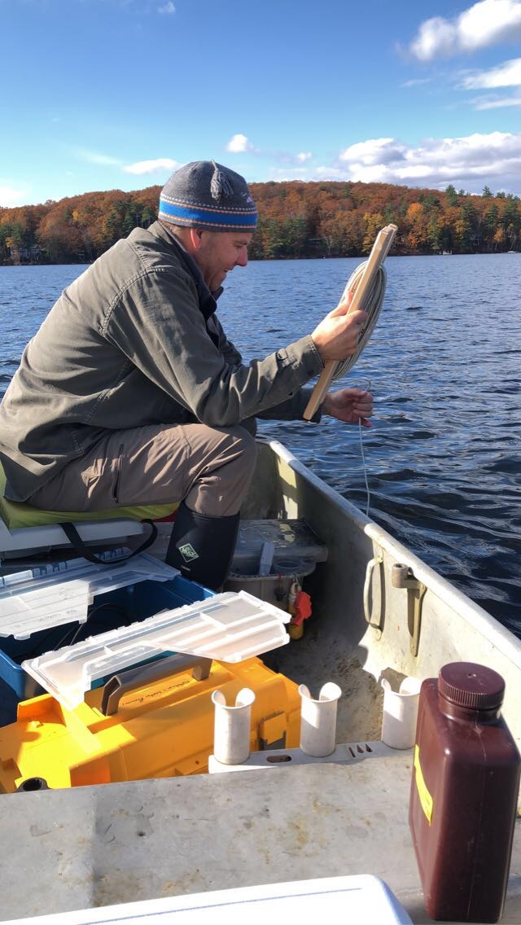
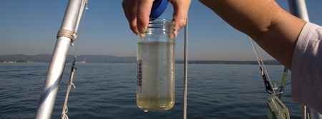
Water Quality Monitoring
Don Kretchmer, Certified Lake Manager
DK Water Resource Consulting
Wolfeboro, NH
Notes:
2008; 2014; 2019; 2021 https://www4.des.state.nh.us/onestoppub/TrophicSurveys/Mirror.Tuftonboro.Cyano.html
Don Kretchmer has continued year-round water testing but we now have a reliable team of our own residents comprised of
Larry Gil
Steve Scapicchio
Tom Bissett
Al Hardiman
Steve Cloutier
Fran O’Donoghue
Val Zanchuk
GOAL: Incorporate Action Items from the MLPA April 19, 2023 Tableau (software) Meeting Examining 40 years of Data from Water Samples
Attendees: Val Zanchuk (presenter) MLPA Vice President; Kathleen Sciarappa MLPA President; Larry Gil MLPA Board; Bree Rossiter Lake Winnipesaukee Association; Al Hardiman MLPA member; Don Kretchmer MLPA consultant; Steve Scapicchio, MLPA Board; Amanda McQuaid UNH; Bob Craycraft UNH (9 total)
(Amy Smagula NHDES sent contributing key questions ahead of the meeting although she could not attend.
Summary of MLPA Water Quality Data Meeting and TO DO Items
Sample the tributaries during storms
Prepare an addendum to the Geosyntec plan
Use the oxygen meter more extensively (we already own it; used for two years)
Continue educating the residents
Take sediment samples of upper layers of sediment (4 inches or 10 cm) Core sediment sampling is essential in understanding the specifics of phosphorus properties in each lake but costly at $5,000-$10,000

Slide 10
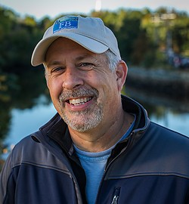
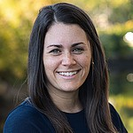
Watershed Management Plan
FB Environmental Associates
Forrest Bell
Laura Diemer
NH CLEAN WATER STATE REVOLVING FUND LOAN PROGRAM (CWSRF)
For municipalities-principal forgiveness up to $100,000
Interest rate 2%-3% length of loan
MLPA $2,000-$3,000 interest only over 10 yrs
Tuftonboro Selectmen: Unanimous vote
June 1^{st:} Application submitted
August: Awardees notified
March: Warrant article
Town of Wolfeboro: CWSRF
Lake Winnipesaukee Association: CWSRF
Notes:
Geosyntec Watershed Management Plan: released in May 2012: Projects listed on page 74 (of a 164 page report) We completed all but the community septic systems.
Time to review all the remediations and check for efficiency. Then, take the plan further.
We have completed all the action items on the first MLPA Watershed Management Plan created by Geosyntec. That took, as expected, about 10 years. We now have the skeletal outline for a second plan with the opportunity to receive $100,000 to assist in the development and implementation of that plan.
FB Environmental: Updated watershed survey (on projects already done)
Get a list from the original plan and go site by site examining for integrity
Compare before and after photos
Create a plan to make sure Best Management Practices (BMPs) are working
Maybe some are partially addressing the issues
Take new photos and create notes on the integrity of each site
Create a spreadsheet of old sites and add any new sites needing attention
Determine pollutant load estimates
Work with committee to prioritize/reprioritize sites needing work
Shoreline survey needed: looking for more sensitive properties
Private areas can only be accessed with permission ahead of time
Do a media blast and other forms of communication to announce the Assessment Team boat is coming to do an assessment from the water 50-100 ft from each property. The assessment includes taking photos for the purpose of updating the Watershed Management Plan.
Think about the politics and create educational awareness
MLPA and Mirror Lake Estates associations need well constructed emails to inform all what is happening with follow ups for properties needing remediation
Boat driver will take the Assessment Team around the lake and evaluate each parcel and establish a baseline
Plan a follow up in five years (then 10 years) to document the changes including tree cutting; lot changes; new homes; changes on the properties etc.
Can quantify changes over time
Characteristics ratings and photos of each parcel are included in the study. Five features are rated at each property; then follow up with property owners advising Lake Winni Blue Program or LakeSmart Program, especially with the highest scoring (most needy) properties. LakeSmart personnel, at no cost, can visit the property and make suggestions on BMPs. Kathy Sciarappa, MLPA President, has already gone through the process and can (will) speak on positive terms about the benefits.
Five Features of the Survey
Bare soil
Shoreline erosion
Vegetative buffer
Setbacks of primary structures
Slope of the property
Update the Action Plans indicated in the Geosyntec plan
Go through each item and provide a status update
What was done; who did it; when was it completed
Discuss what’s worked; what hasn’t
A spreadsheet, that is ultimately a table, will be added to the plan
Add new action items as needed for new BMPs
Update and analyze the water data
How has water quality changed in the last 10 years?
Has the change indicated we need to remediate further?
i.e. the impact of the spray fields and “cease and desist” impact
Field work
sediment testing
storm event testing

Slide 11
Resolutions: MLPA Board
Resolved that the MLPA, along with the Conservation Commission, present to the Board of Selectmen that the town of Tuftonboro apply for a $100,000 forgivable loan under section NHDES Clean Water State Revolving Fund, to develop phase two of the MLPA Watershed Management Plan. If such loan is approved by the state of NH, the MLPA has agreed to reimburse the town Tuftonboro up to $4,000 that represents the interest only on the loan.
Resolved that MLPA authorize up to $10,000 to engage a certified lake manager company to take core sampling of the deep hole area of Mirror Lake to determine the nature and composition of the sediment for the purpose of future mitigation and planning. $7,465.80
Notes:
All in favor Resolution #1 regarding the NHDES Clean Water State Revolving Fund
Aye
Nay
Abstain
All in favor Resolution #2 authorizing up to $10,000 for care sampling and analysis
Aye
Nay
Abstain

Slide 12
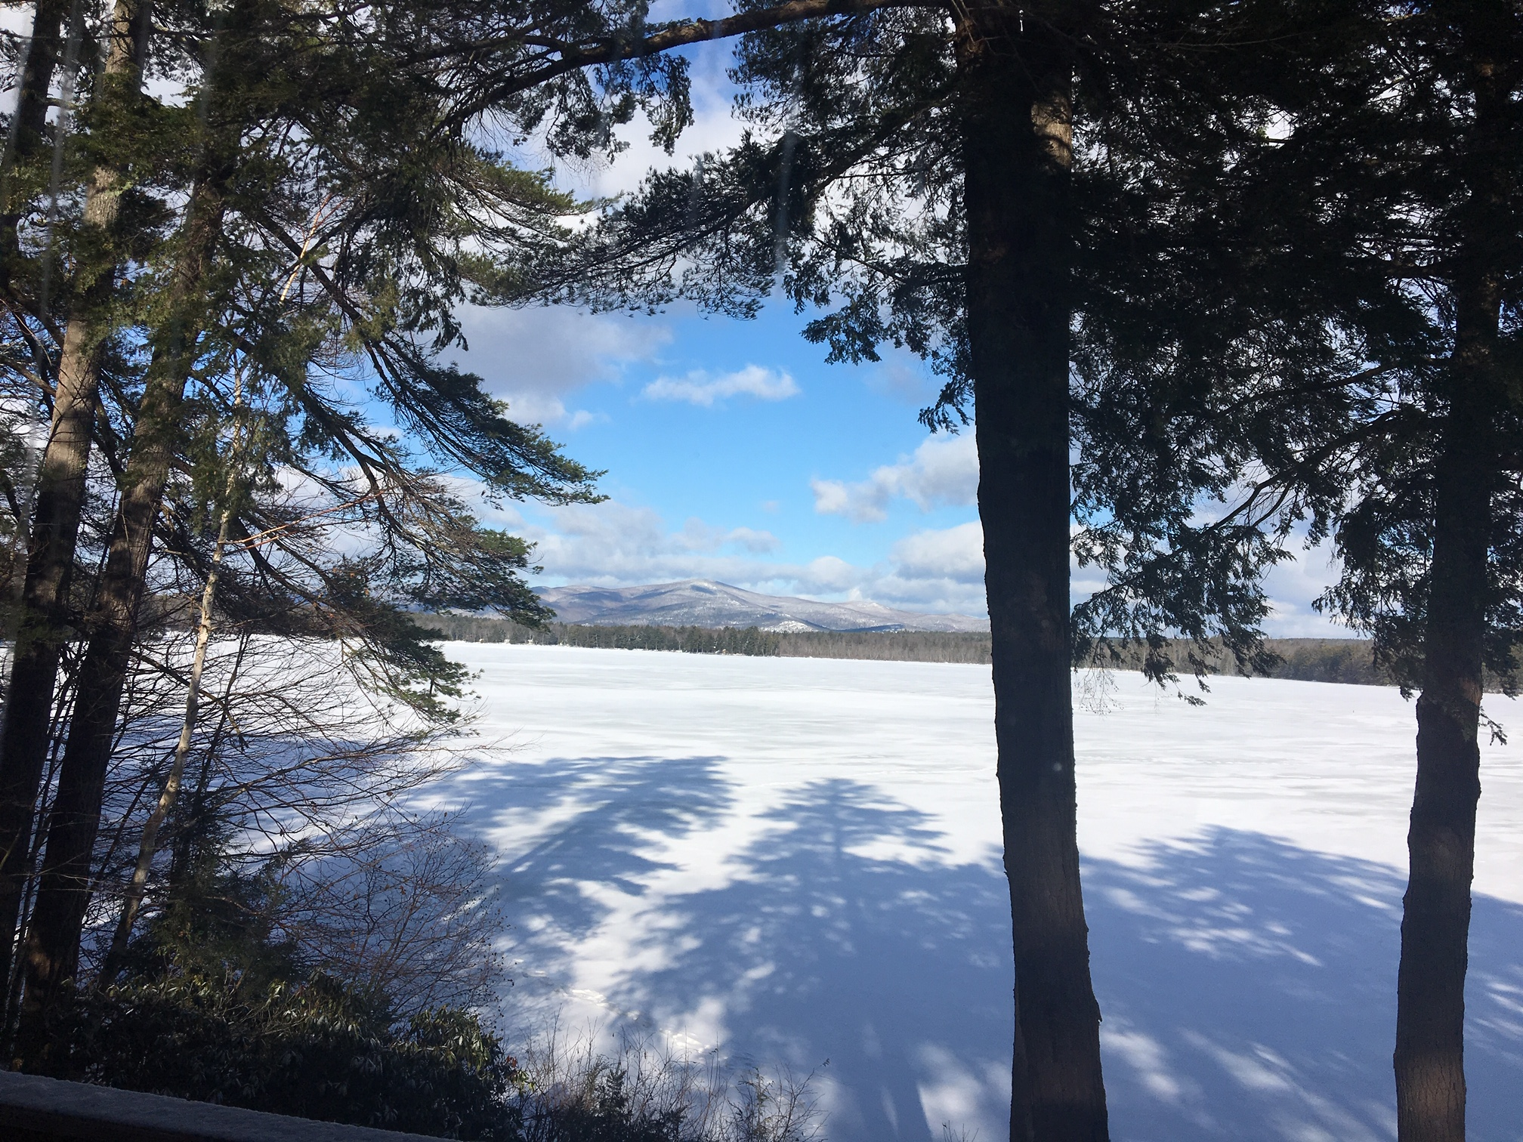
Land Conservation Committee
John Dawson, Chair
Notes:
Outcome of the meeting held at John’s house:
Review of Where we’ve been’ where we are now; where we are going
Tuftonboro Conservation Commission (Steve S and Larry) have been instrumental in major purchases
Issue of 100 acres plus and our research into smaller lake associations and how are they approaching easements (purchase and monitoring)

Slide 13
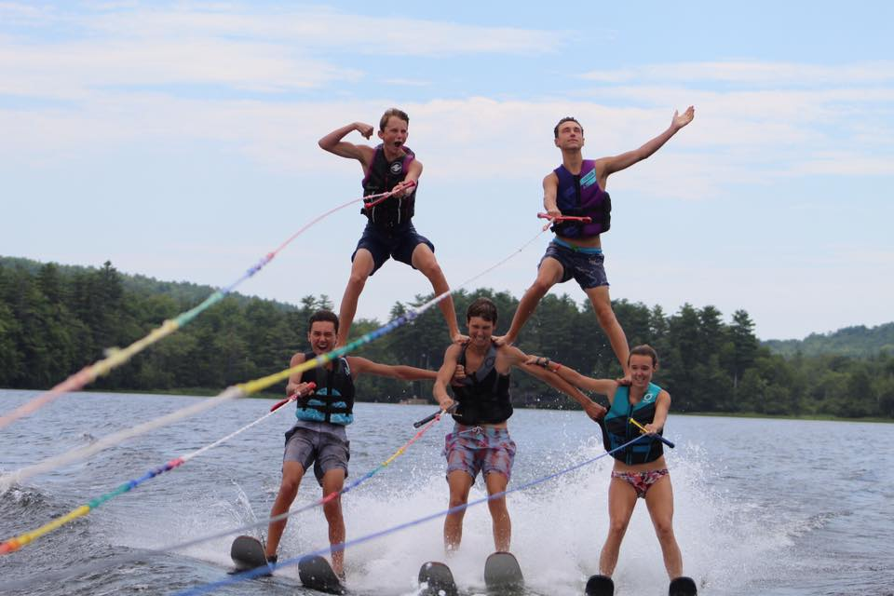
MLPA Committees/Teams
Notes:
Here’s some nice teamwork on Mirror Lake! We, too, depend on our volunteers.

Slide 14
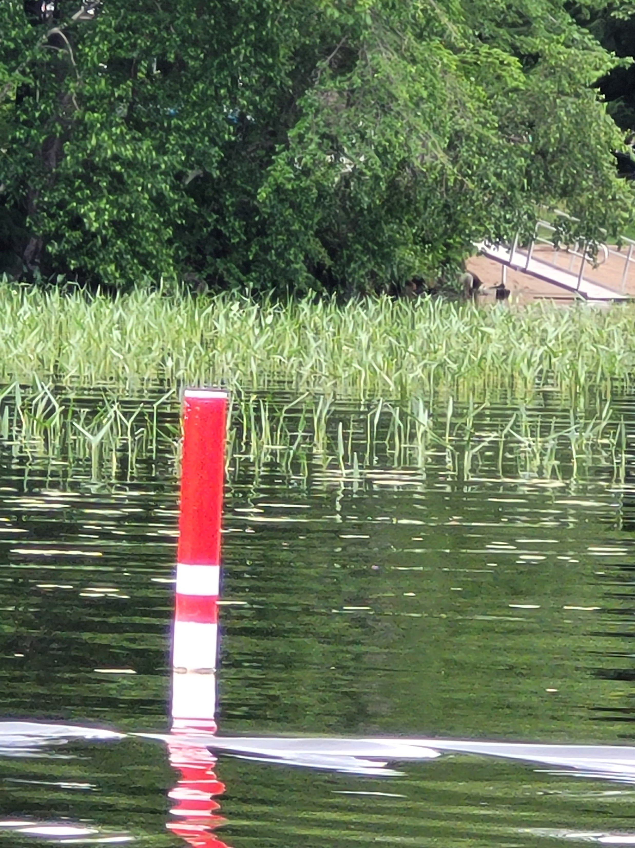
Buoys and Markers
Notes:
Steve Cloutier called the state and they came out and moved the markers last summer after several boaters hit rocks.

Slide 15
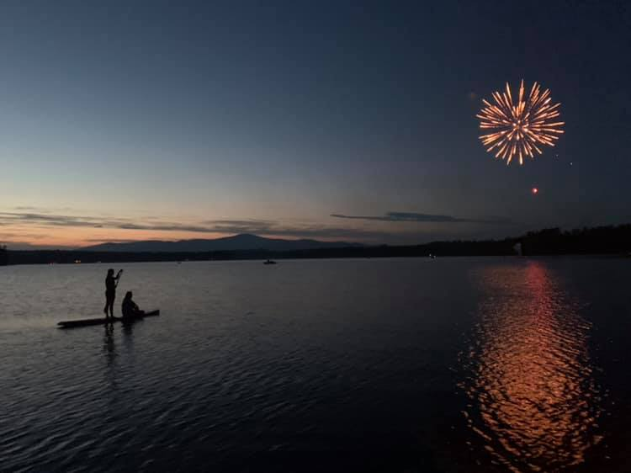
Community Engagement
Beth Argeros Fran O’Donoghue
Notes:
Saturday July 15, 2023 MLPA Annual Meeting 9:00am Tuftonboro Fire Station189 Middle Road Center Tuftonboro, NH
Wednesday July 19, 2023 Mirror Lake Afternoon Boat Social 4:00pm Middle of Mirror Lake
Wednesday August 2, 2023 Mirror Lake Mingle @ Bistro 19 5:00pm Bistro 19 at the Kingswood Golf Club 24 Kingswood Rd Must RSVP for numbers
Wolfeboro, NH
Saturday August 5, 2023 Community Yard Sale TBD TBD
Wednesday August 16, 2023 Dock Socials 4:00pm On your own dock or at your neighbor’s dock!
Sunday August 20, 2023 Kids Cardboard Boat Race 10:00am Lang Pond Road Beach
Emails will be circulated; the events are listed in the Tuftonboro Times

Slide 16
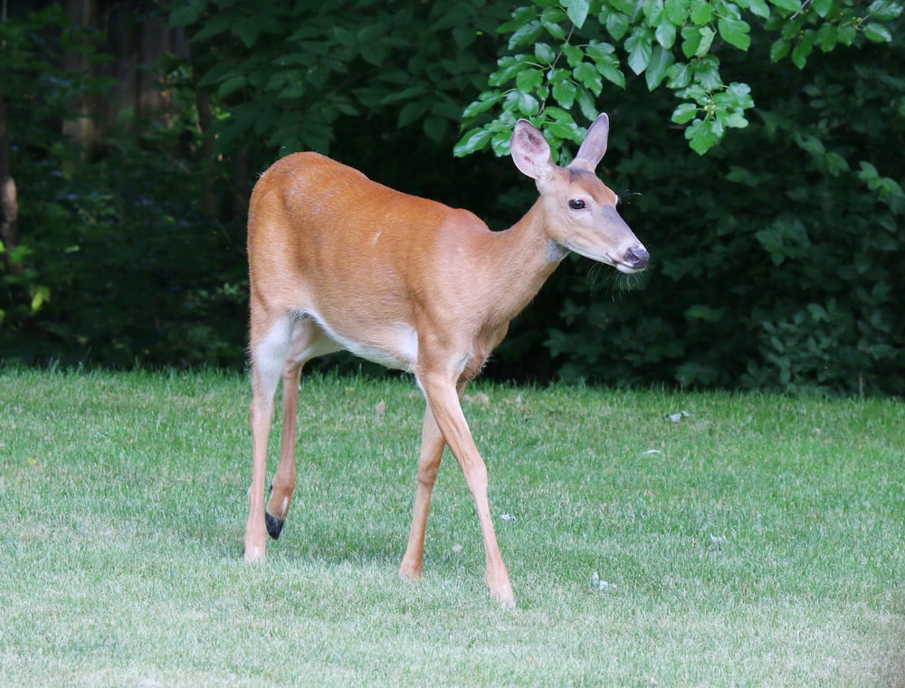
Finance: In Memory of…
Notes:
Sad to announce the deaths of four key MLPA members this past year: Steve Briggs (Museum Shores) who always gave so generously to MLPA and his wife Doris continues to do so; George Davies (Chipmunk Lane) who sponsored events at his home, including bocce ball tournaments to raise money for MLPA along with his wife Dusty Davies; Jim Laurence (Church Lane) who kept the Native American spirit alive in his compound for kids and grandkids over many years along with his wife Joan; Bill Tryder (Mirror Lake Estates) who created the earliest MLPA website and kept the membership rolls as well as sent emails regarding key events on the lake while his wife Julie engaged in key committees serving the MLPA. Perhaps there were other losses this year of Mirror Lake residents.
We encourage Mirror Lake families to think about Leaving a Legacy as you help preserve Mirror Lake for future generations.

Slide 17
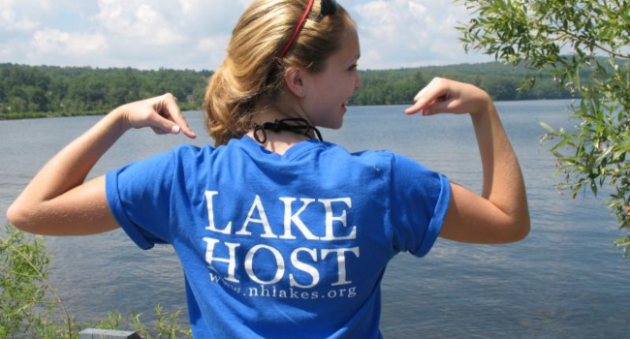
NH Lake Host Program
Notes:
Thank you MLPA for bumping up the pay for Lake Hosts to $15 an hour! Now we have two paid employees. But the grant supplies most of the salary and we are obliged to provide an equal amount of volunteer hours for all paid hours. We still need coverage!
Thanks to our team we do have some coverage:
Steve Cloutier
Denise Ferriman (paid Lake Host)
Larry Gil, Chair
Al Hardiman
Denise Katz (paid Lake Host)
Carol Lavelle

Slide 18
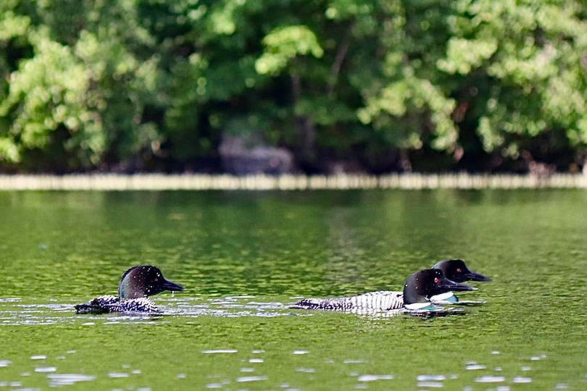
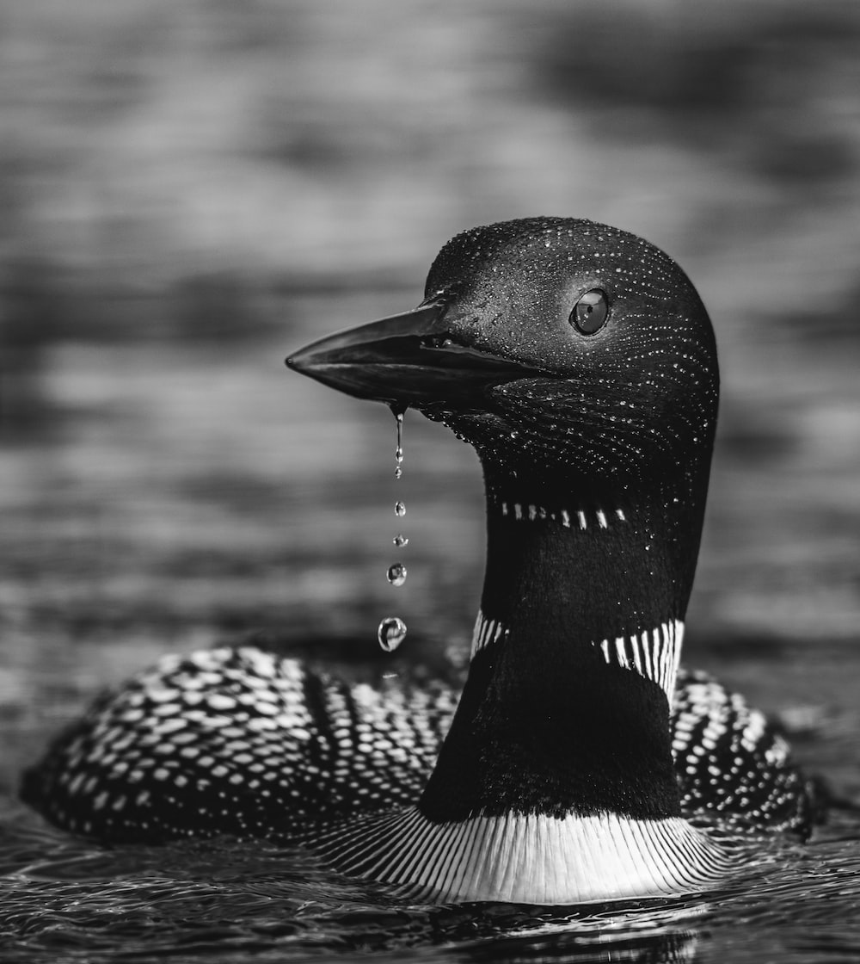
Loon Update
T.R. Wood
Notes:
TR offered to take care of the loon nest this year and he reports that he spoke to the summer biologist who has been monitoring the nest. The last observation she took was on June 20th. 3 loons were observed. 1 female and 2 males assumed. The 2 males were observed fighting. Nothing on the nest observed.

Slide 19

Membership
Goal: 100 Members
2022-2023: 74 members
29 Active Volunteers = 39% MLPA involved

Slide 20
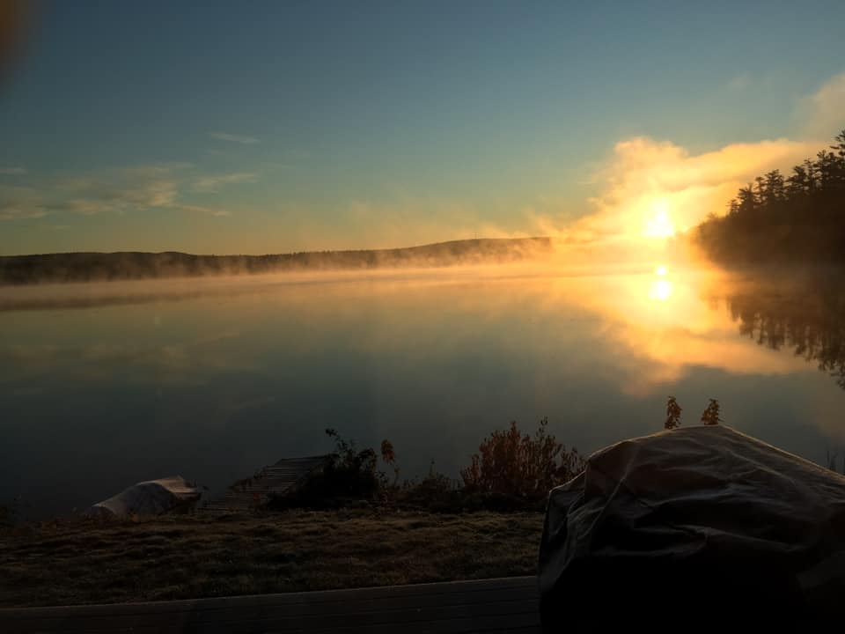
Website/Communication
mirrorlakenh.org

Slide 21
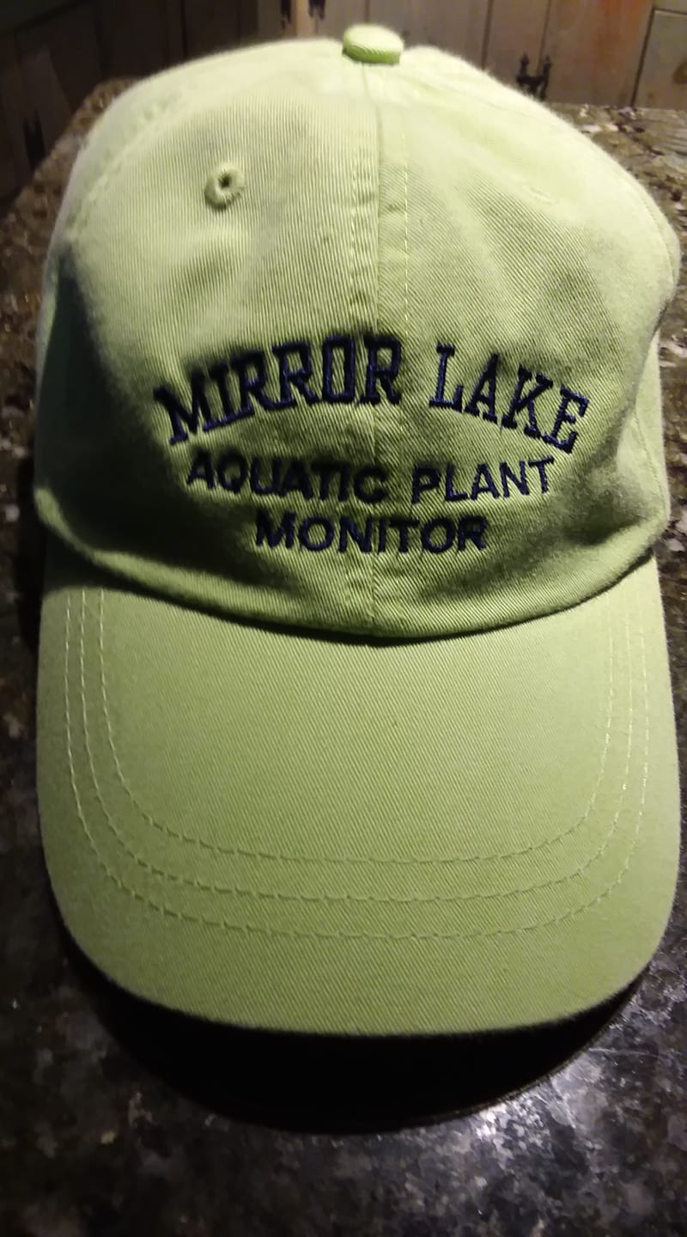

MLPA Apparel
Notes:
MLPA is making hats, shirts, sweatshirts, vests, towels and tank tops available for purchase. Emails were sent to all. If you would like to add your email to our list, a paper is being passed around

Slide 22
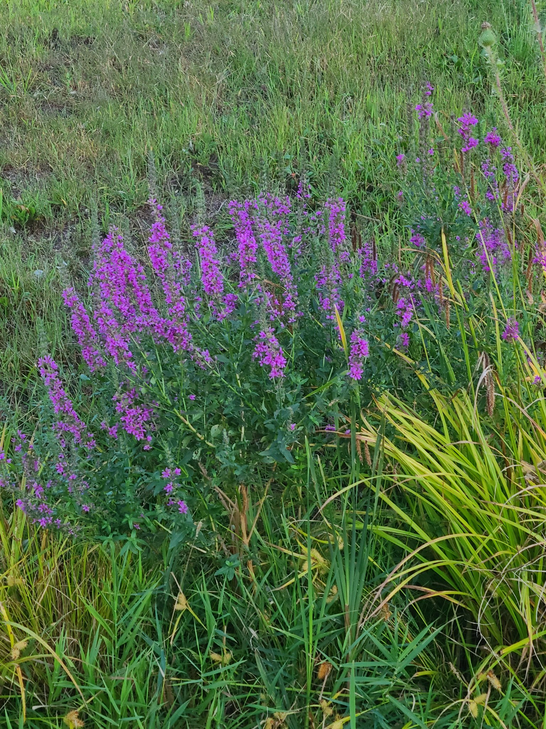
Aquatic Plant Monitoring Program
“Weed Watchers”
2023 Team
Claudia and Tom Bissett
Jeanne Freeze
Alan Hardiman
Kip Lachner
Norma Milne, Chair
Glenda Philbin
Tiina Urv
Notes:
Norma will report

Slide 23
Welcome Team
Chipmunk Lane/Oak Hill
Mirror Lake Estates
Governor Wentworth Highway
Museum Shores: Doris Briggs
Anna McCarthy
Church Lane and side areas

Slide 24
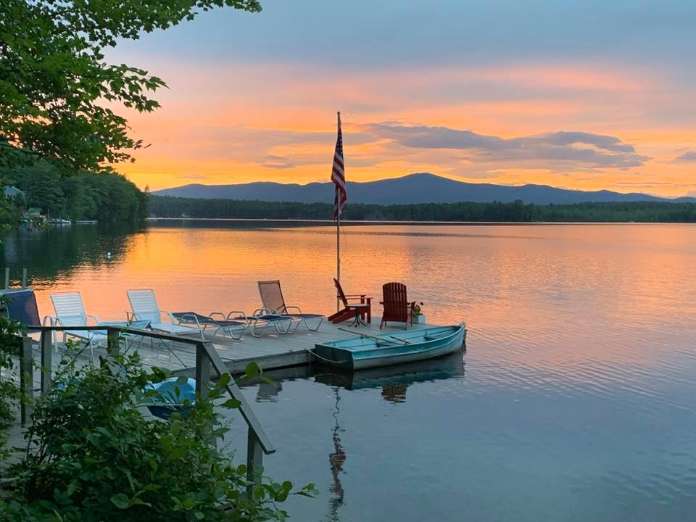
Old Business

Slide 25
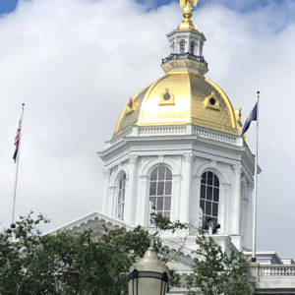
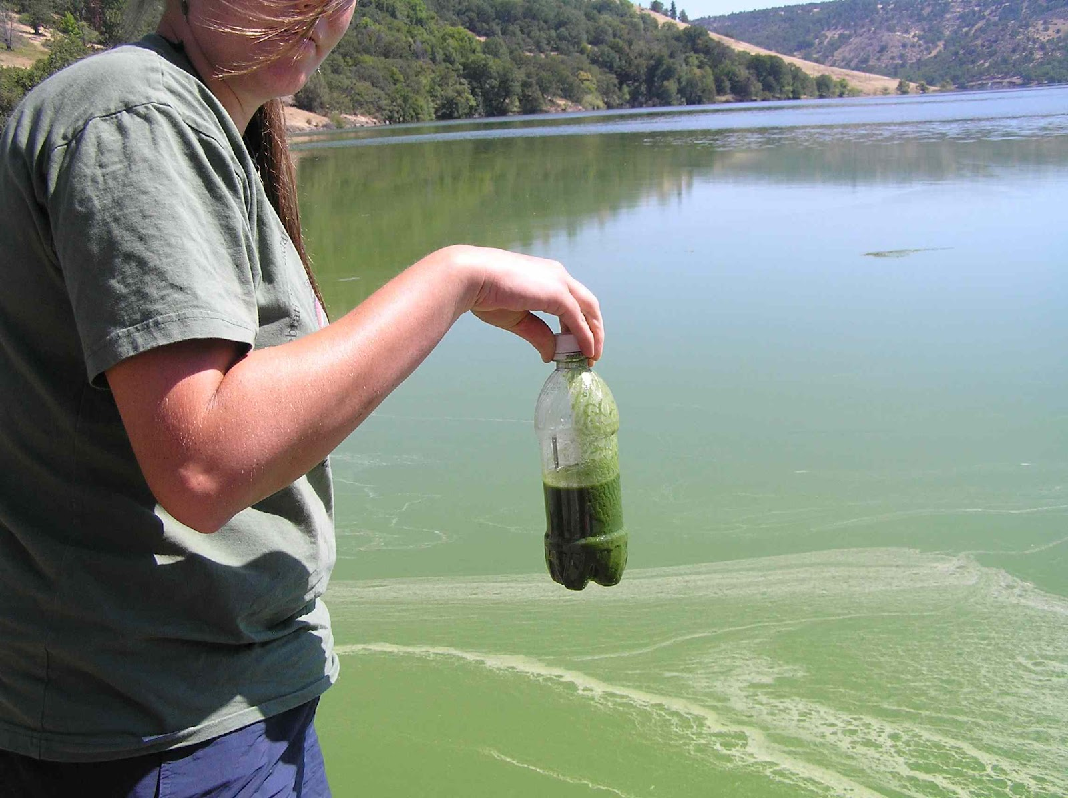
NH Legislation and Regulations
Notes:
After MLPA letters of support for forming a statewide cyanobacteria study team and funding clean up efforts, that has all passed.

Slide 26
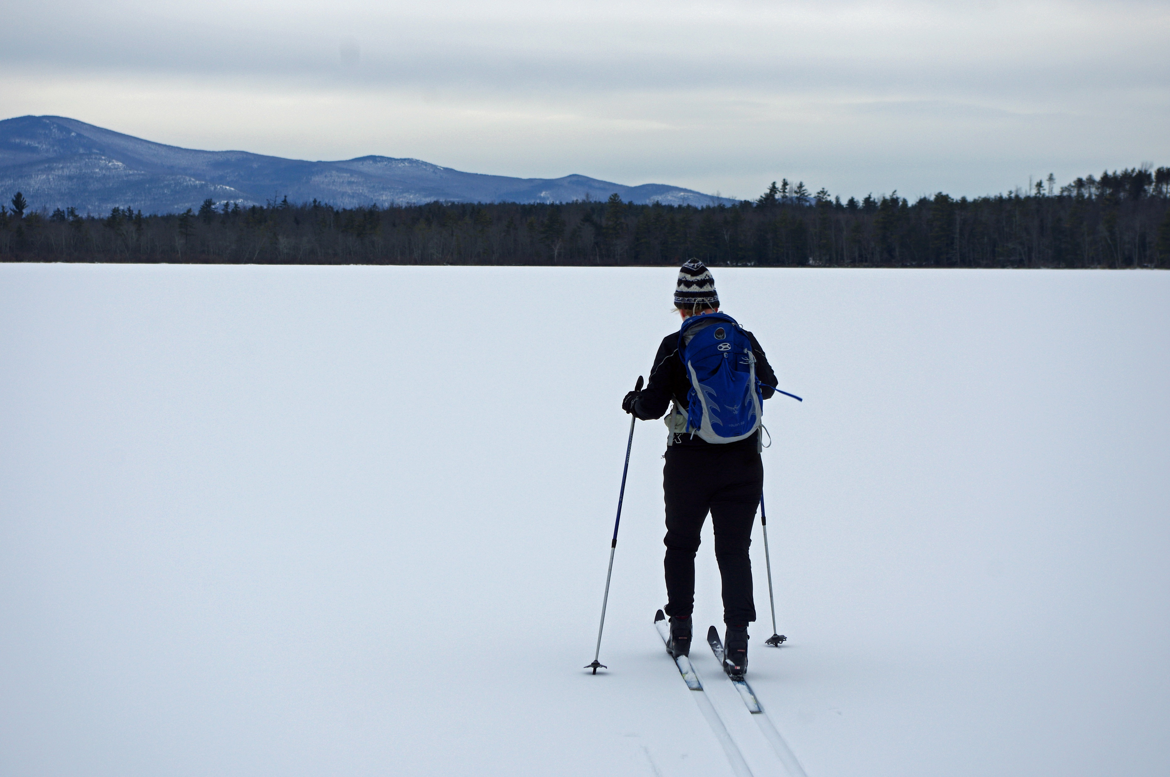
New Business

Slide 27
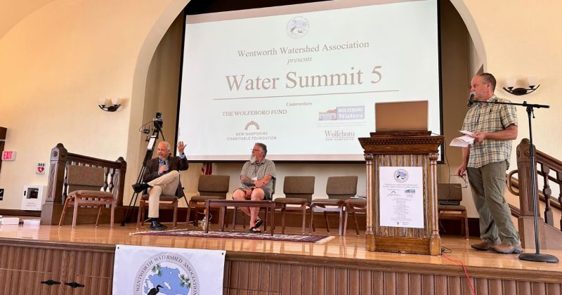
Water Summit
Notes:
MLPA has formed important relationships with The Lake Wentworth Watershed Association and Exec Director Julie Brown; the NH Lakes Association and President Andrea LaMoreaux; the Lake Winnipesaukee Association and Executive Director Pat Tarpey and more recently, the Wolfeboro Waters, led by Warren Muir. Through cooperative efforts we are making progress for the entire region.

Slide 28

NH Lakes Congress https://nhlakes.org/lakes-congress
Notes:
13 Key Points from the Lakes Congress 2023
The Abenaki tribe had a portage (carried boats) by the Libby Museum… Paul & Denise Pouliot
Doug Darling: NHDES Cyanobacteria Advisory Committee Chair;
David Neils, Chief Aquatic Biologist NHDES
Lakes that have recurrent blooms have a decrease 20-23% property value…
Global increase of blooms; of bloom intensity and frequency; typically dissipate by 2-3 wks
Can be aerosolized so people shouldn’t be in a kayak or canoe
NHDES Cyanobacteria Advisory Committee Goal: Controlling and eventually stopping cyanobacteria outbreaks; 10 Year Plan
All lakes have a Legacy Load; now realizing most blooms rise from deep waters (i.e. Deep Spot)
Stormwater is the greatest contributor
3rd party reviews are effective (i.e. LakeSmart visit)
Kate Hastings NHDES Cyanobacteria Program Manager
3.5 billion years on Earth: cyanobacteria have competitive advantages
2022 Season: 46 advisories on 35 lakes
Best Practices: Improve stormwater management; shoreline plantings; septic control ---LakeSmart
Stick test: if it’s green, stringy, goopy and sticks to the stick…it’s NOT cyanobacteria
Reports are both earlier (May) and later (Dec.) Blooms can occur under the ice (113 lakes since 2003)

Slide 29

LakeSmart: Lake-Friendly Living

Slide 30
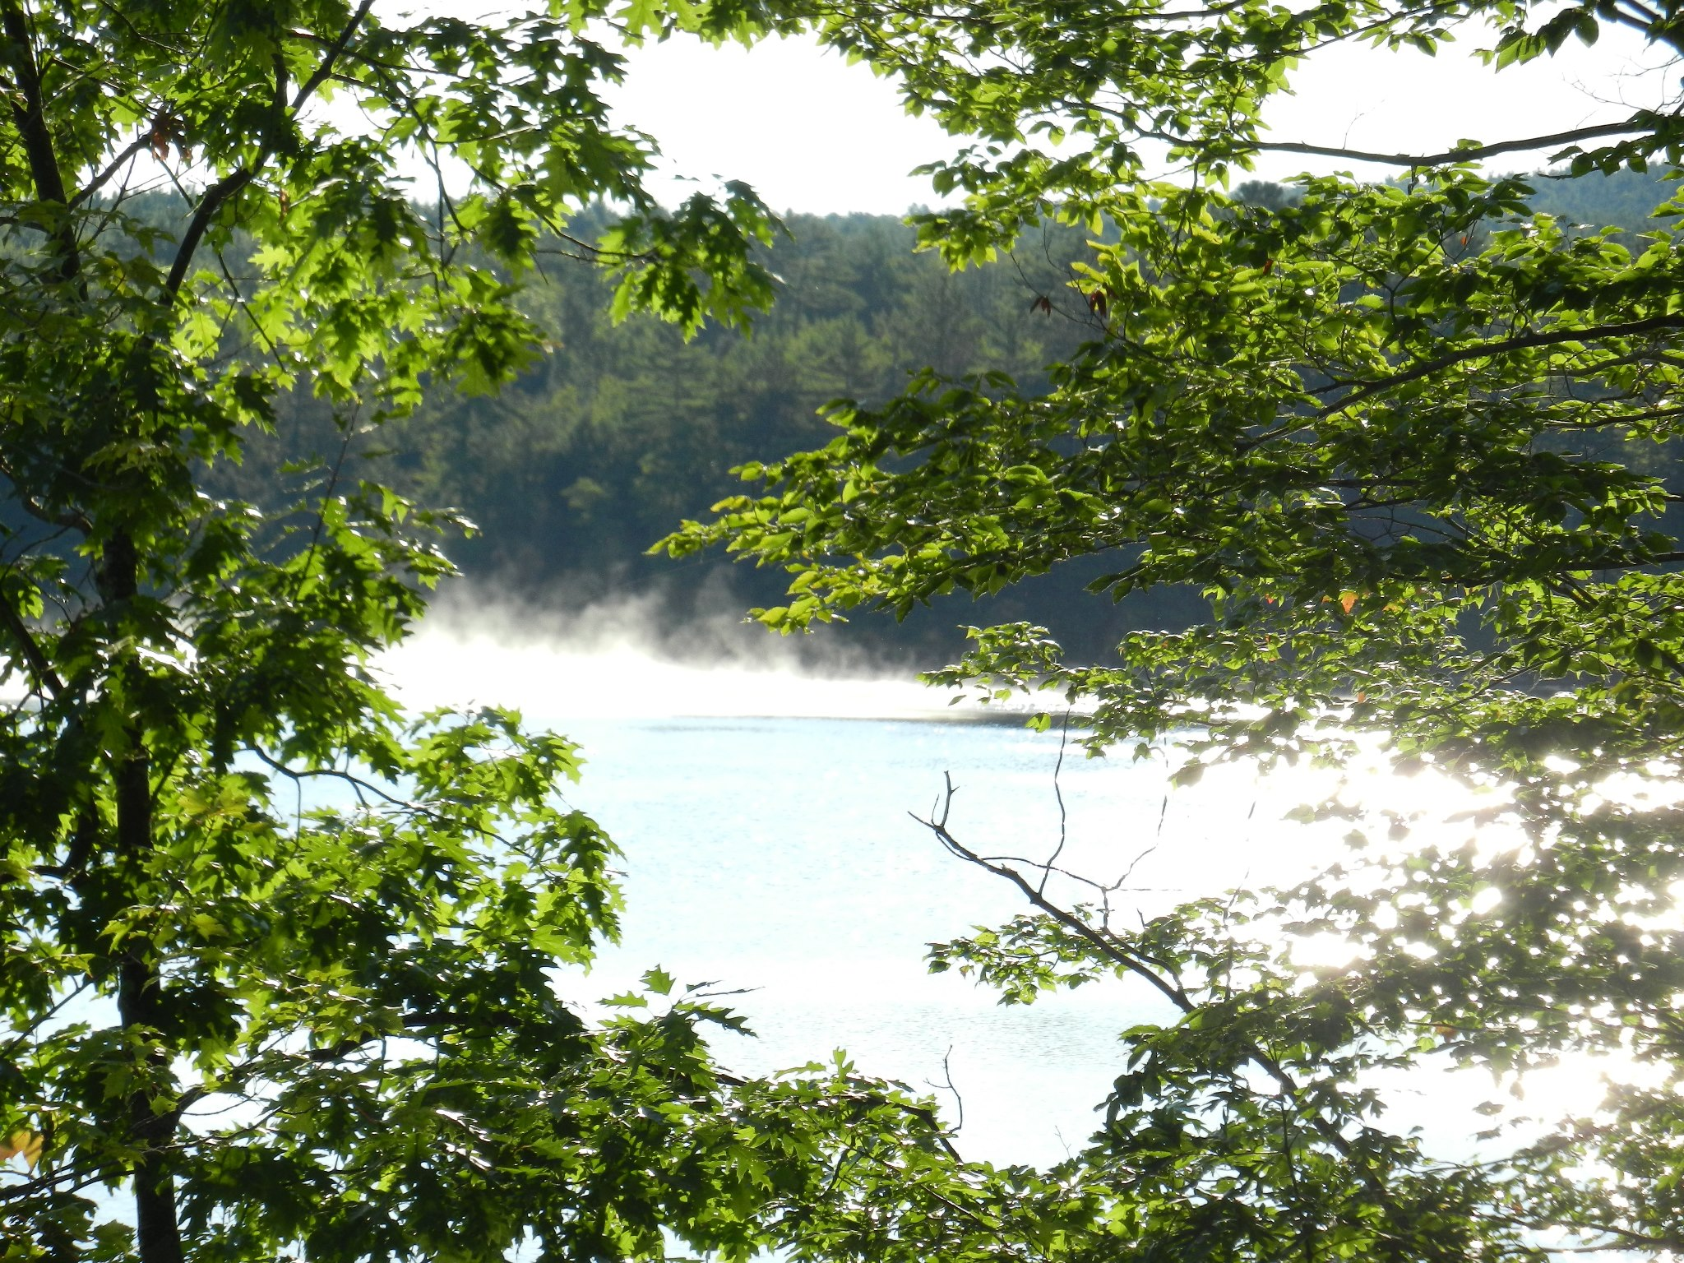
Thank you MLPA!

Slide 31
Treasurer’s Report
Robin Muench, Treasurer
Notes:
Robin is not in town for the next couple of weeks, but worked to prepare the report. Our treasury grows slowly, but steadily.

Slide 32
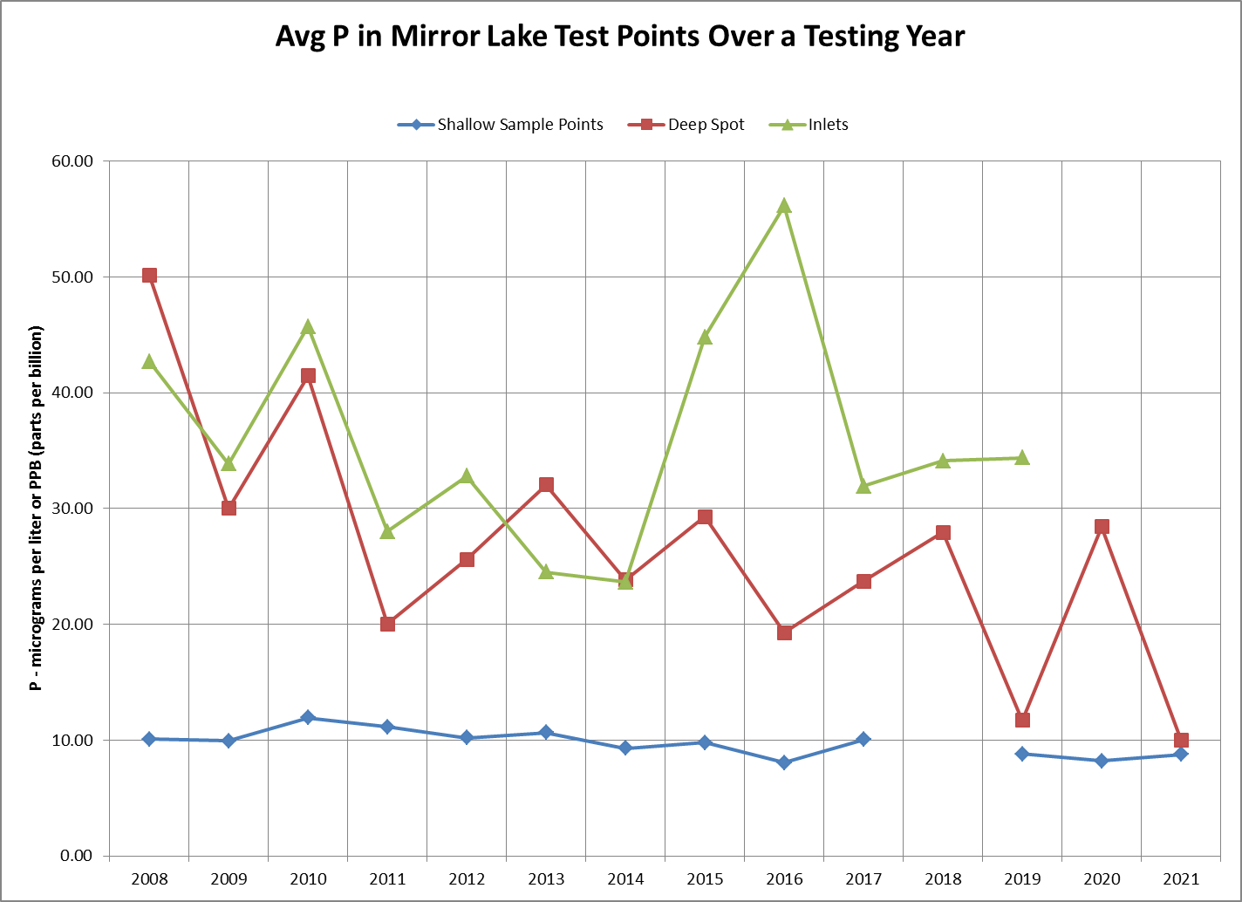

Slide 36
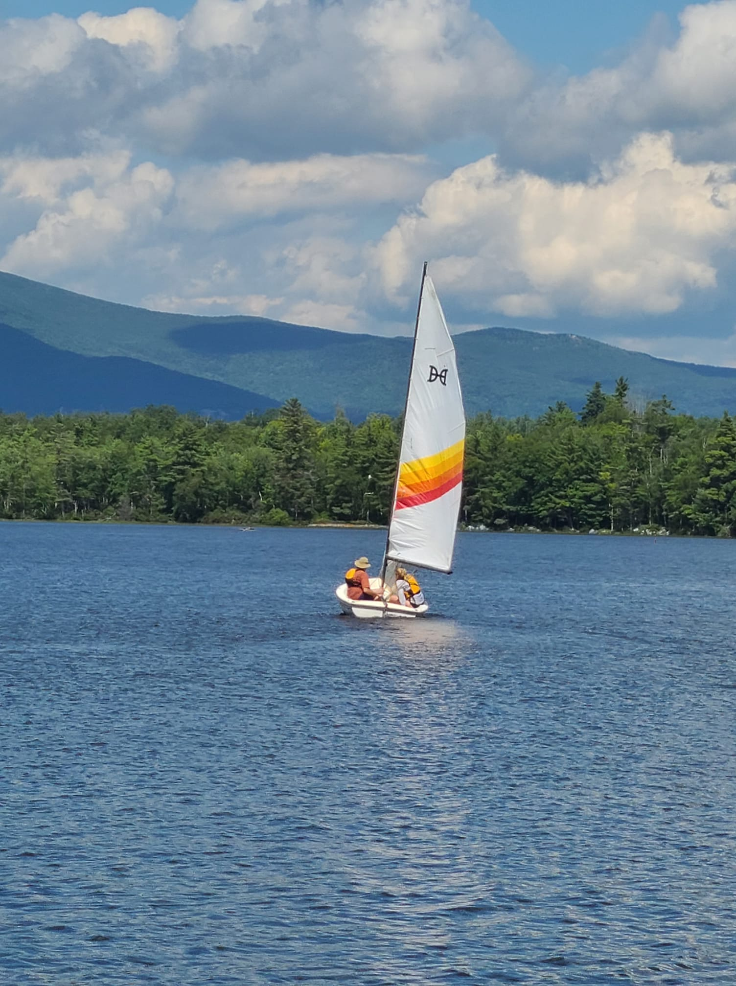
MLPA Strategic Plan
  GUIDED BY:
  Sciarappa Entry Plan interviews
  Wolfeboro Water Summit
  Lakes Congress
  Geosyntec Mirror Lake Water Management Plan (Bob Hartzel)
  Rapid Ecological Assessment
  (Rick Van de Poll)
  UNH Extension/NHDES reports
Notes:
A strategic plan to guide the work of the MLPA is underway.
Kathy Sciarappa has interviewed all MLPA board members; some key officials in Wolfeboro and Tuftonboro; and lake leaders for Lake Wentworth; Lake Winnipesaukee and NH Lakes to gather ideas for strengthening the two areas of focus: 1) clean water; 2) land conservation. Reports specific to Mirror Lake and annual conference attendance are quite helpful.

Slide 37
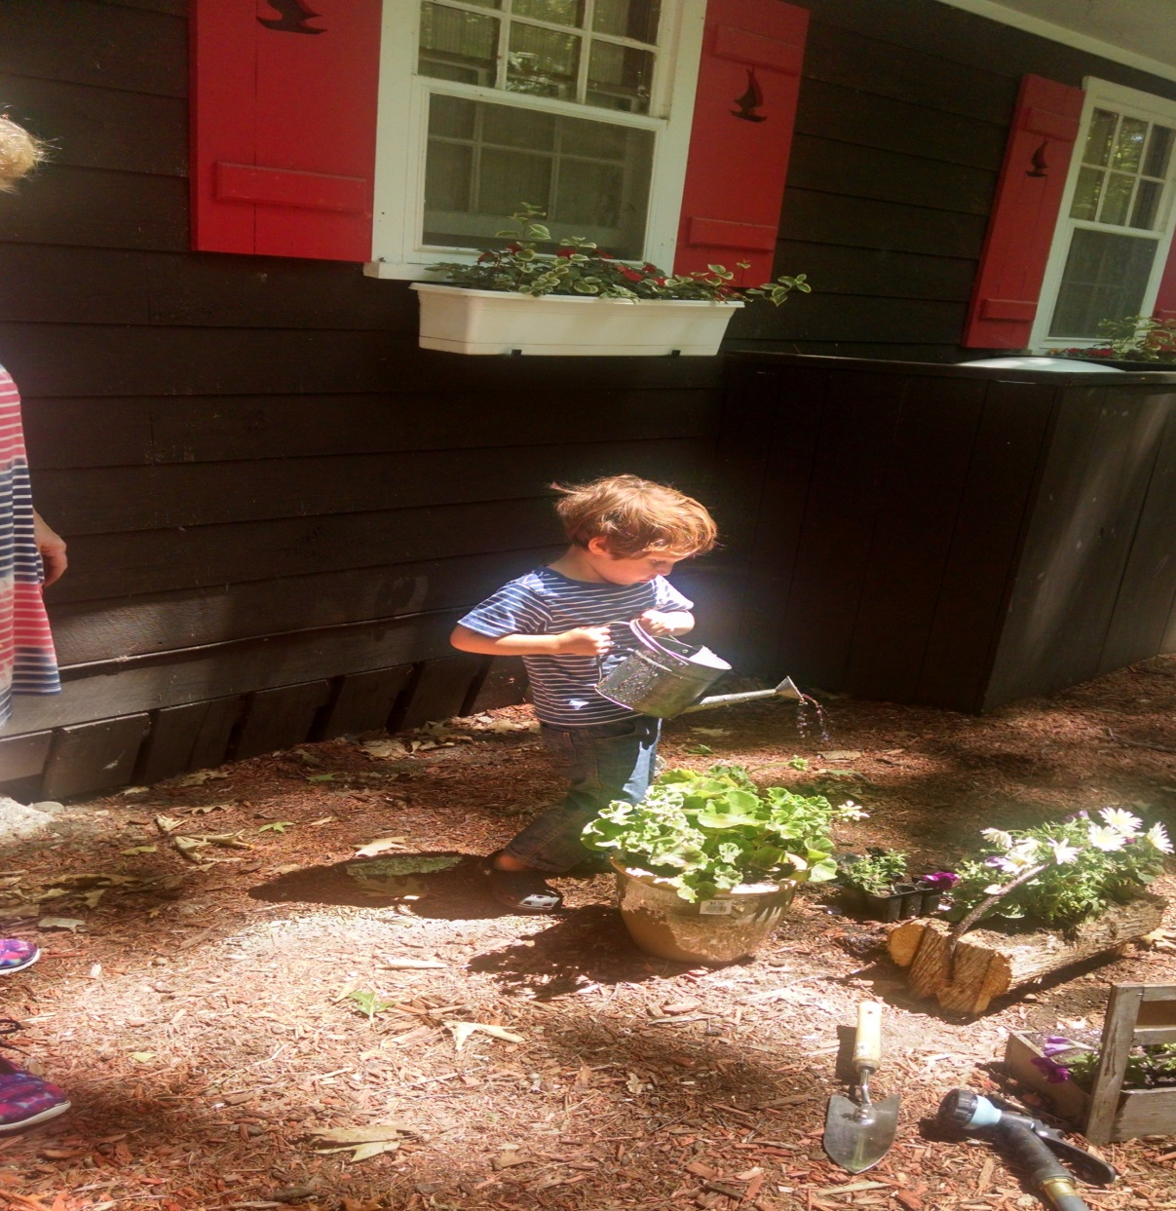
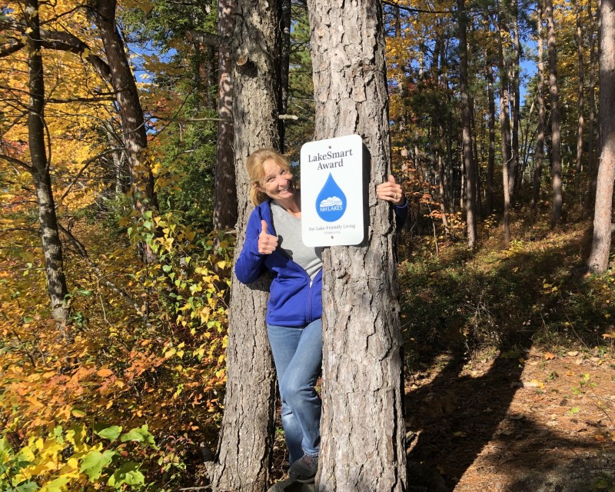
LakeSmart
Notes:
The health of Mirror Lake is dependent on property owners. But sometimes, we don’t know exactly what to do to be helpful. LakeSmart is a process to help property owners increase lake friendly practices. Everyone here today will be given a letter with details. The first step of the process is a self-assessment. Kathy Sciarappa has gone through the self assessment and visit. People can take the self-assessment without the visit. Her final report should be ready in three weeks.
She was already told that the left section of her leach field is starting to erode, something she had not noticed. She was also offered a simple solution of transplanting ferns from her woods to shore it up. Simple! The self-assessment alone is very helpful in identifying best practices in four areas: 1) Inside the home; 2) outside the home; 3) along the shoreline and on the water; and 4) in driveways and parking areas.

Slide 38
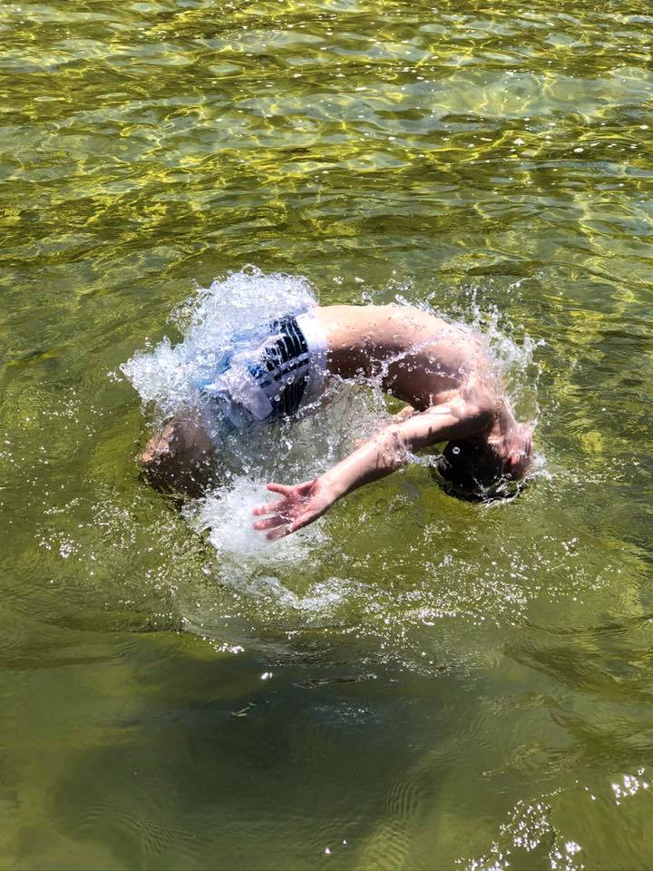
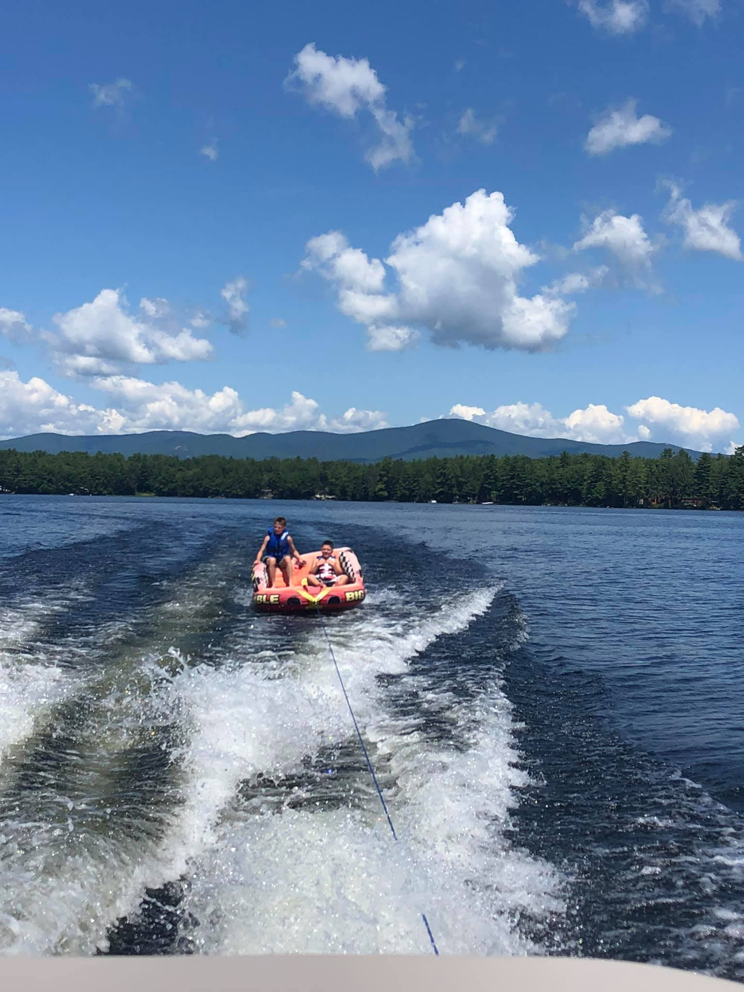
Watershed Management Plan
Notes:
The most critical piece of the strategic plan will be a new Water Management Plan which will likely direct us for the next ten years. This year we will concentrate on applying for grants to help pay for the preparation of a new plan. The original Geosyntec plan was written in 2012 and we have completed all the recommendations except one. We do not (yet) have any community septic systems.
The town of Tuftonboro has been very helpful and generous, especially with warrant articles, to help us complete the plan. Our thanks to the Selectmen and town!

Slide 39
Membership Goal: 100
Current: 54 (still coming in)
Notes:
We have about 100 homes on the shoreline of lake, but MLPA is also comprised of homeowners in Tier II, Tier III and the watershed as a whole. Some members are incredibly generous and we would like to thank everyone who has joined the organization with special thanks to those who have been so generous. You’re inspirational!

Slide 40
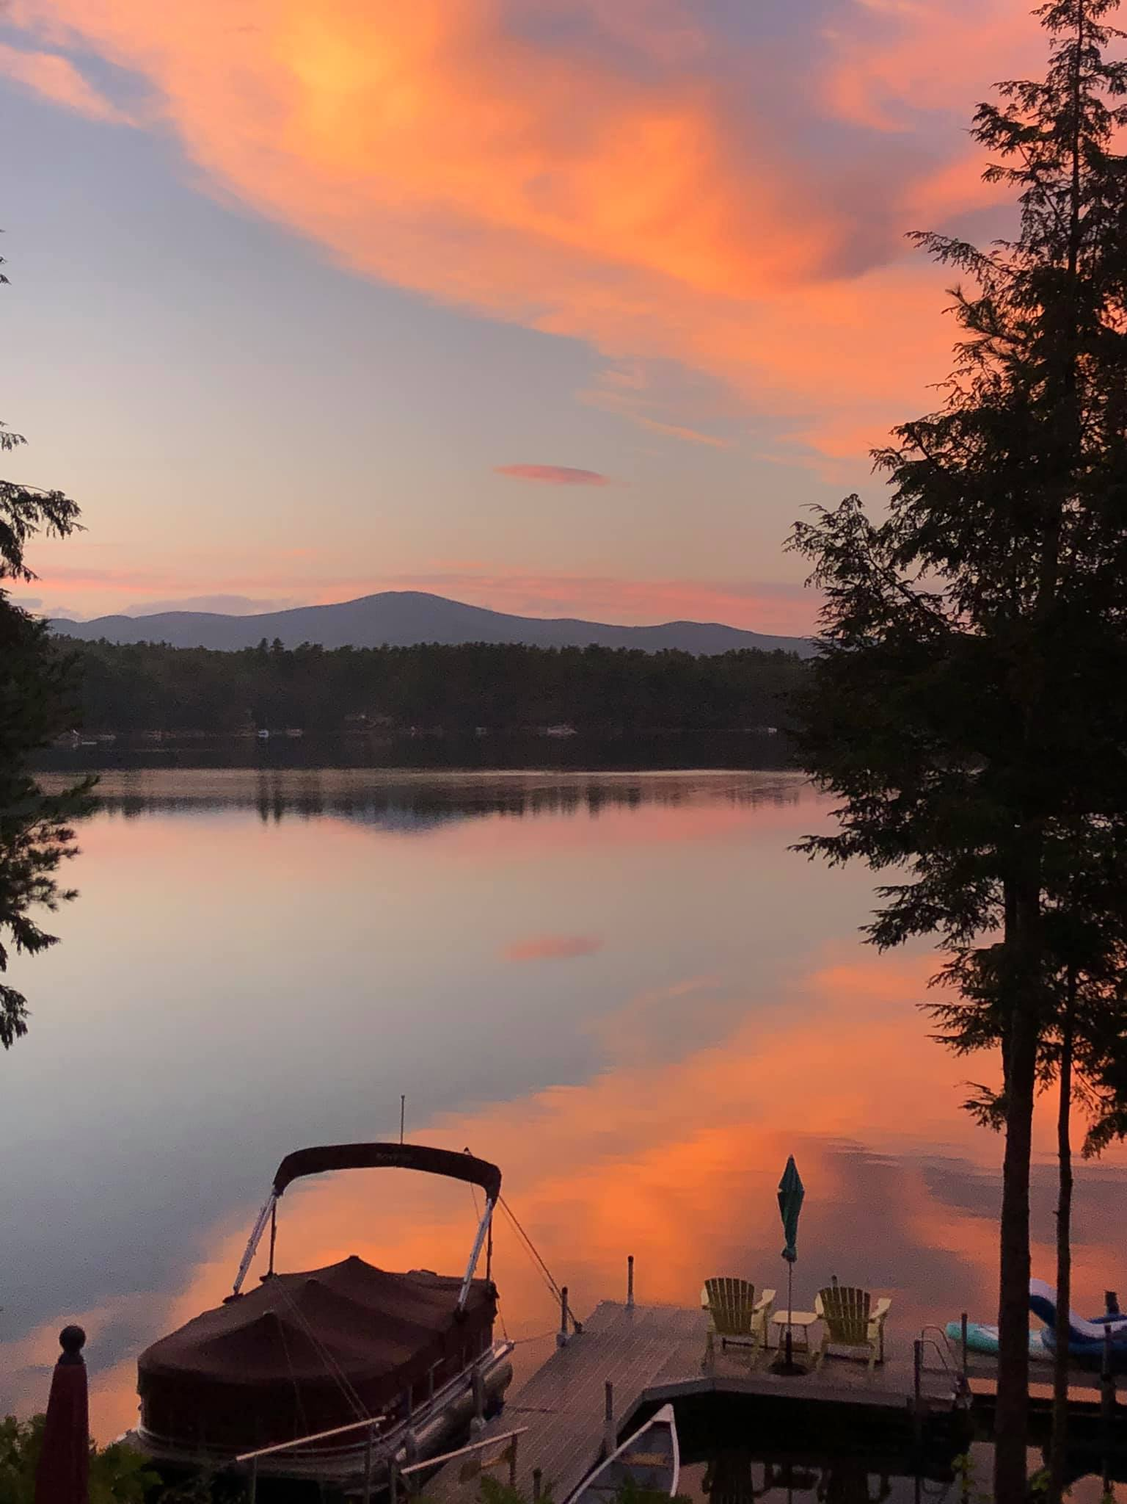
How to Help
MLPA Areas of Focus
    Clean water
    Land conservation
Support Needed
Membership
Financial Guidance
Community Engagement Event(s)
Website upgrade/communication
Notes:
Membership contributions are very helpful but active participation is the heart of any organization. The Entry Plan interviews revealed two areas of focus and four areas of need. Please consider donating some of your precious time to MLPA. There are jobs that can be done in an hour per month. Lakes Hosts and Weed Watchers are always welcome but the four areas of need are:
Membership: to keep addresses and names current
Financial guidance: to help monitor our financial future
Community Engagement: to sponsor one event such as a kayak race; a dog meet up; a cocktail party; Casino Night; a hike; a musical event etc. Or any other way to enhance community.
Website upgrade/communication: to enhance/redesign our website; create a blog relating healthy lake information; a newsletter…anything that will help keep our community informed
Contact Kathy Sciarappa kathleensciarappa@gmail.com

Slide 41
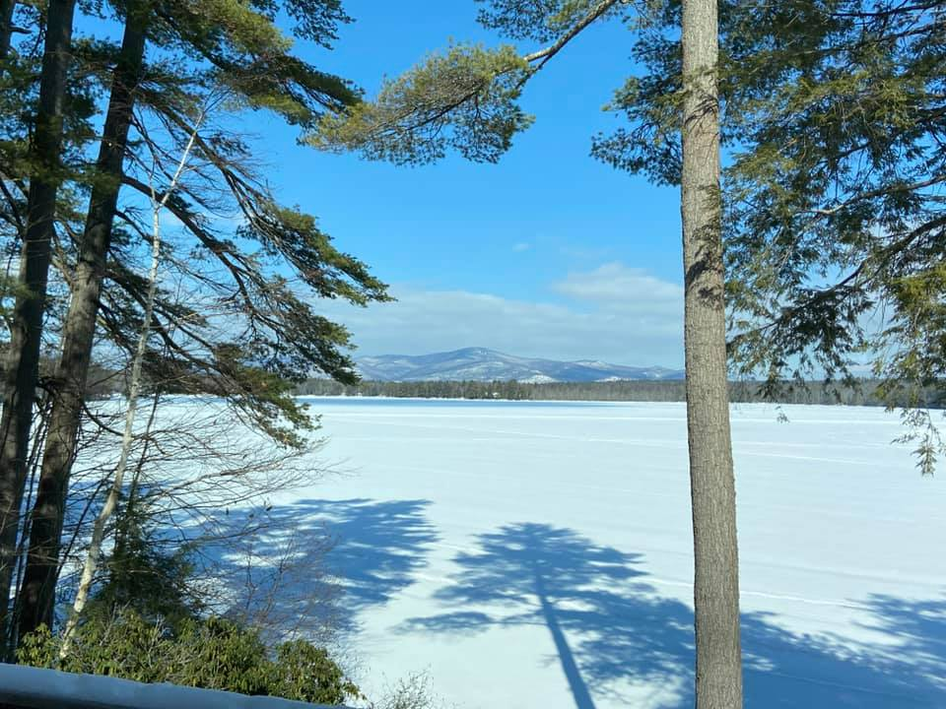
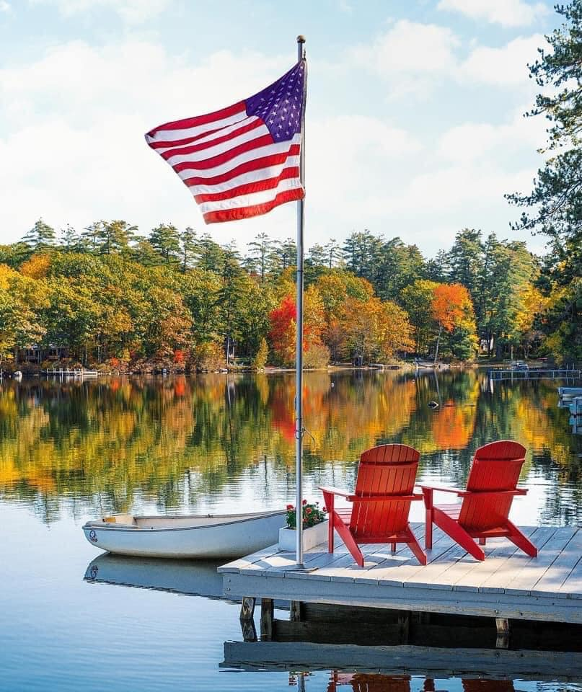
Open Discussion
New Business
Old Business

Slide 42
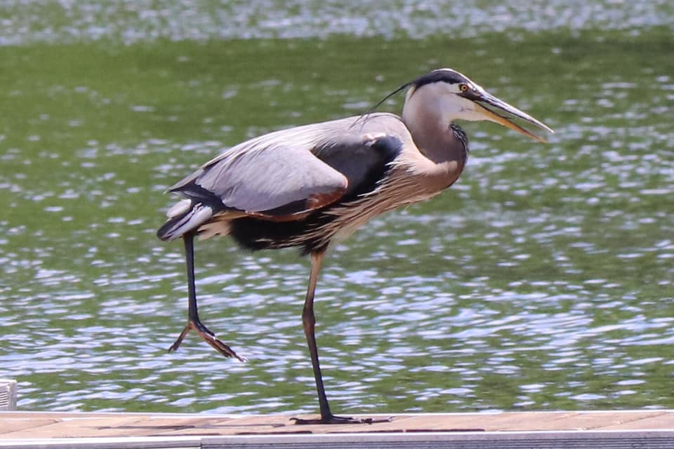
Resolutions
Notes:
You received 3 resolutions that the board worked on over the winter in the letter sent by mail.
Revised Mission Statement
Allow the board to expend in excess of $2000 as needed to protect the interests of the organization (i.e. to hire a consultant)
Creation of a Finance Committee
Motion
2nd
Discussion
Yea/nay/abstain

Slide 43
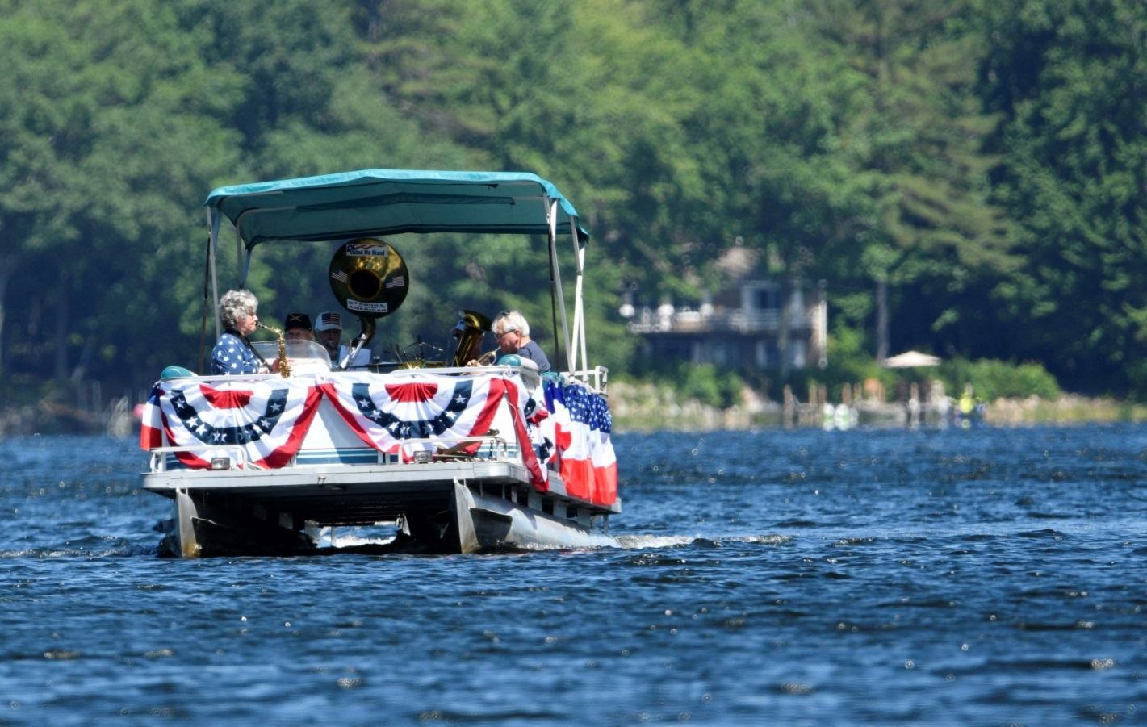
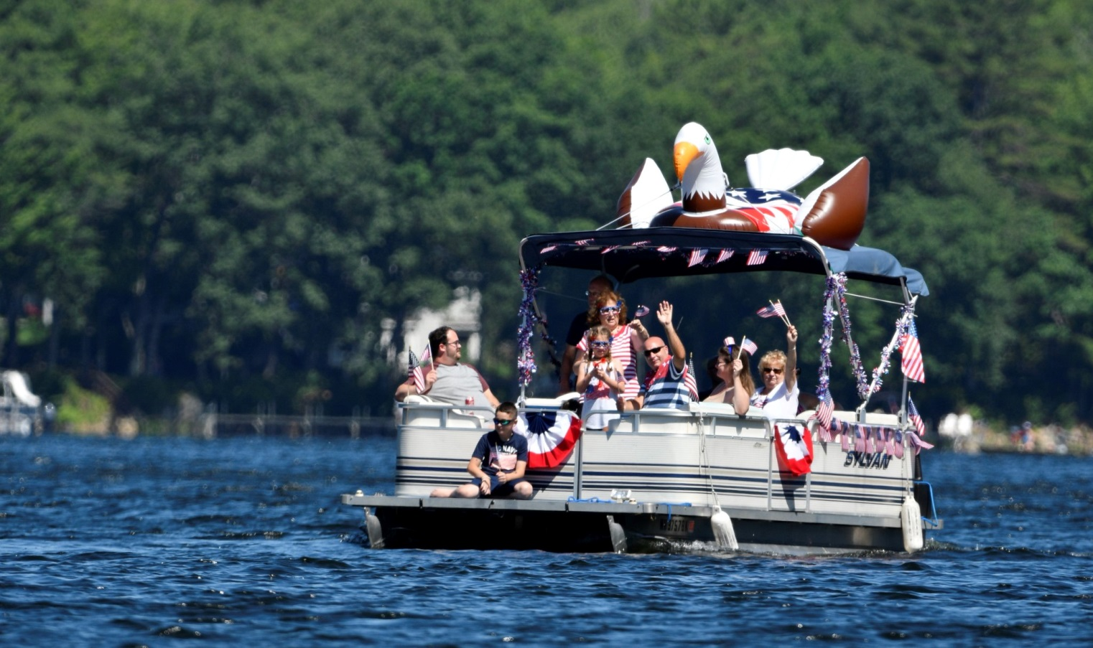
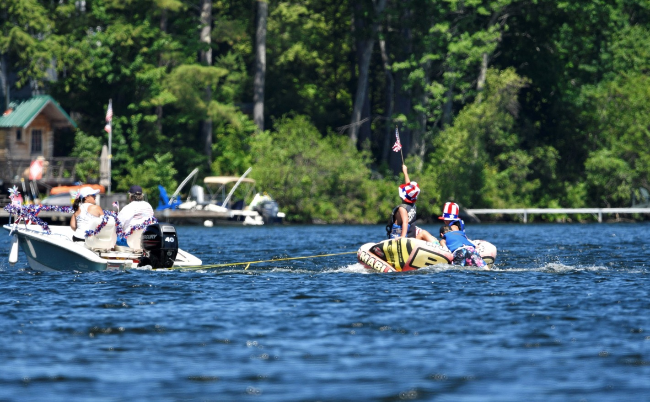
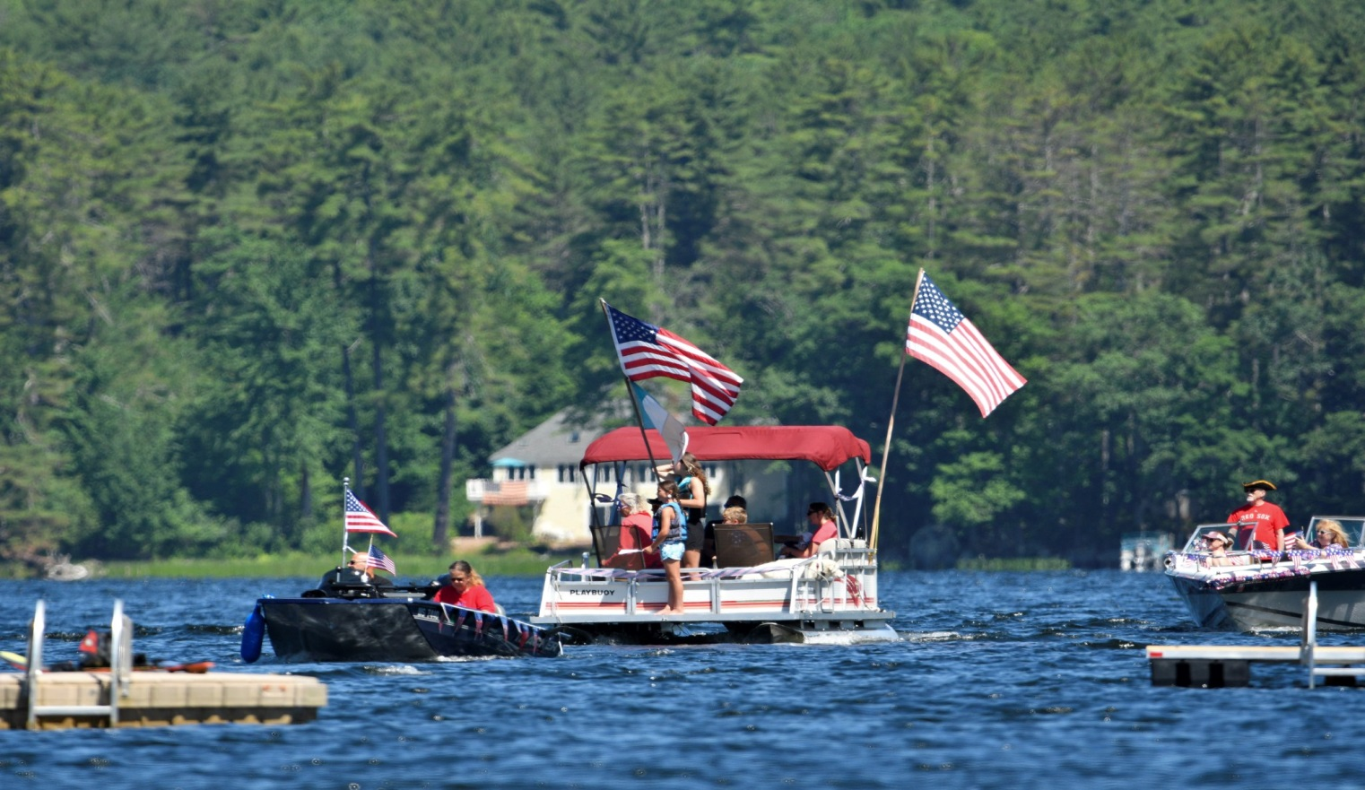
Thank you, Beth Argeros
Notes:
We had a great July 4th boat parade this year with excellent participation! Thanks to all of you who showed up either as onshore audience or parade participants. Special thanks to our superb MLPA Patriotic Band. Next year: We need a sound system!

Slide 44
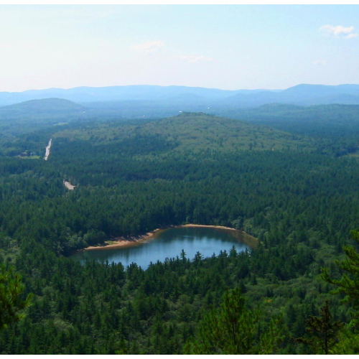
Thank You for Protecting Mirror Lake!
Notes:
Thank you, all. (Hopefully the 10am deadline was met)

Slide 45
AGENDA
Welcome
Approve Minutes
Treasurer’s Report
Nominations
Committee Reports
Water Quality:
  Report a Bloom; Mapper; Updates
  Water Quality Monitoring
  Watershed Management Plan
  RESOLUTIONS
Land Conservation
6. Other Committees/Teams
7. Old and New Business
-Water Summit and Lakes Congress
- LakeSmart: A Lake-Friendly Living Program
8. Adjourn
OTHER COMMITTEES/TEAMS
Buoys and Markers
Community Engagement (Social)
Finance: In Memoriam
Loons
Membership
  74 members; 29 active volunteers
  39% level of participation
Nominations
Lake Host HELP NEEDED
MLPA Apparel HELP NEEDED
Website/Communication HELP NEEDED
Weed Watching HELP NEEDED
Welcome Team HELP NEEDED

